Slide 1
Taking Action: Applying what we know to make a positive difference
Pack 2 Lesson 3

Slide 2

Lesson objectives
Identify examples of appropriate environmental Youth Activism.
Apply examples of Youth Activism to a local situation.
Justify the importance of a local topic to a target audience.

Slide 3
Lesson outcomes
Explore examples of how young people have made their voice heard against major environmental issues. ​
Present your arguments to a target audience explaining their importance to the environment.​
Use persuasive language to communicate an emotive issue to a target audience.

Slide 4
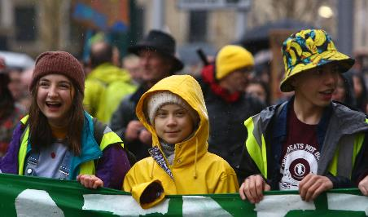
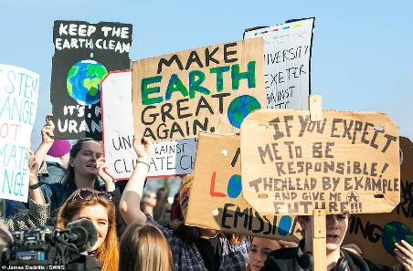
What is Youth Activism?
Young people are standing together to make a difference.
Use these images to:
Describe how young people are making their voices heard.
Explain the issues are they trying to bring attention to?
Suggest the intended impact of their actions.
Notes:
Youth Activism – young people must have the opportunity to lead change within their own communities, this could be writing letters to newspapers, petitioning elected officials, running or contributing to a political campaign. Demonstrative forms of activism include rallies and street marches. Greta Thunberg is a Swedish environmental activist who is known for challenging world leaders to take immediate action for climate change mitigation.

Slide 5
Young People’s Legislation
Read the article, this is an example of Youth Activism. Answer the following questions:
What are students going to parliament to ask MPs for?
How is this an example of youth-led climate and environmental social action?
What do students want to be added to the National Curriculum and why?
What impact will this have on young people’s future actions?
First ever legislation written by pupils | News | Young People's Trust For the Environment (ypte.org.uk)
Notes:
Young people are getting involved in legislation, the article (https://ypte.org.uk/news/first-ever-legislation-written-by-pupils) illustrates how groups such as YPTE have entered parliament to lobby MPs on changes to education to include as a matter of urgency teaching and learning on the climate emergency and ecological crisis. This example of Youth Led Activism is working to support the education of all young people to make a long term changes for themselves and their communities.

Slide 6
Young People’s Legislation
Write a new Bill to go to Parliament addressing how the Bioeconomy can begin to tackle the climate emergency. You want to persuade MPs to vote in favour of this Bill so it becomes Law.
Resources
?
Energy
What should the bill address?
Transport
Education
?
Waste
Notes:
The students should think about how the Bioeconomy can support positive actions towards the climate emergency.
Legislation – laws
Bill – Proposed legislation or law, it must first be debated and then approved by each House of Parliament, once it become law it becomes an Act. Any member of Parliament can introduce a Bill.
Students should think about what laws they would like to change in order to tackle the climate change emergency, this may be energy, transport, waste laws, personal consumption of resources, education.

Slide 7
Young People’s Legislation
The introduction
Begin with an introduction about yourself or the organisation you represent:
I am a student at ___________ High School.
Follow this up with a brief statement of your issue:
We are asking for your support with ___________
Make this relatable, why is this issue important to everyone?
Include specific facts, examples of how the
Bioeconomy can tackle the climate emergency
and have a specific impact on your local area.
Notes:
Students should use their ideas for change to write their legislation. They should make it clear why their bill is crucial using statistics from the factsheet. The language used should be persuasive and actions should be linked to the Bioeconomy. Young people are encouraged to think how these changes can have a specific impact on their local area.

Slide 8
Young People’s Legislation
The Bill (give it an appropriate name)
This is your opportunity to state what you want to be included in your legislation:
1.
2.
3.
4.
5.
State five specific actions and explain the impacts each will have on the climate emergency
Notes:
Students should suggest five specific actions linked to the Bioeconomy that should become law. For example, all vehicles should be powered by renewable resources, the impact of this will be xyz. Challenge students to suggest the impact this will have in their lifetime.

Slide 9
Look at everything you have learned
Thinking about Youth Activism, name one positive action (change) that individuals could do to support the Bioeconomy and in turn climate change.
?
Remember: The size of one person's footprint is mind boggling
?
Notes:
This concluding slide asks students to reflect how they as individuals may choose to make a positive change. Encourage them to remember that the collective impact of one small action repeated by millions of individuals will have a greater impact than one person working alone. Individual action on climate change can include personal choices in many areas, such as diet, travel, household energy use, consumption of resources, as well as engagement in local and political advocacy around issues of climate change.
There are 7 billion people on the planet. CO2 emissions vary by country. The https://edgar.jrc.ec.europa.eu/report_2021 showed that in 2020, the global average was 4.7 tonnes per person. The average across European Union nations was 5.9 tonnes per person. In the USA, the average was 13.7 tonnes.

