Slide 1
The Great Debate

Slide 2

Lesson objectives
Apply knowledge and case study information to critically argue various points of view in relation to the Bioeconomy​
Make a judgement as to whether the bioeconomy can support a sustainable planet​
Understand the difference between fact and opinion​
Make a prediction for the future of the planet based on a balanced judgement.

Slide 3
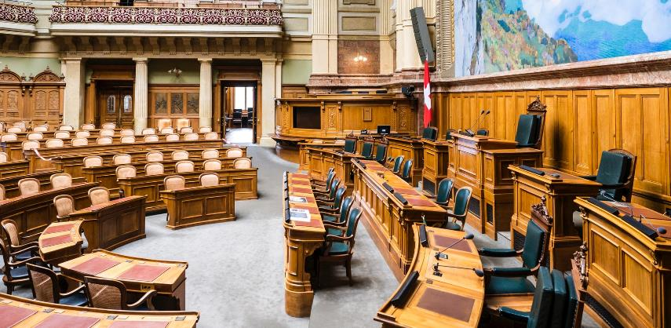
Lesson outcomes
Prepare an argument using facts and opinion
Make links between different viewpoints to build a more robust argument
Form a balanced opinion and predict the success of the bioeconomy now and in the future.

Slide 4

Let’s debate
“The world we live in is currently unsustainable. The Bioeconomy will
solve this.”
Society
Environment
Economy

Slide 5
The world we live in is currently unsustainable. The bioeconomy will solve this.
What are the various arguments for our debate?
Think:​
Who do you represent?​
Are you for or against the issue?
Notes:
Allocate, or allow students to select, a group of people to represent e.g. Youth, Resident of low-lying coastal area, Doctor, Inventor, Politician, etc.
You could use the case studies from Pack 1, Lesson 2 to support this, but we recommend making their choice of roles as relevant as possible to your class.
Some potential examples:
Youth who wants to make a positive contribution to their planet and local community, supporting other people to also do the same.
Resident in a low lying coastal or estuary area. Sea level rise is causing them to be flooded frequently. (Holderness Coast, Humber Estuary)
Doctor who relies on plastic to keep people safe but also recognises the environmental impact of plastic waste. (Talapia, Brazil)
Inventor who wants to replace an everyday product with something from the Bioeconomy. (Carvey Maigue)
Challenge groups:
Fossil fuel Energy Provider who produces energy via fossil fuels, with the increase of renewable energies they have noticed a loss in profit. They have been funding research in support of fossil fuels.
Offshore Oilrig transport worker - woman with 3 children who is employed to fly oil rig workers to the platform each rotation. She recognises that climate change is a bad thing but her career depends on the extraction of fossil fuel.
Environmental Charity (against deforestation) supporting wildlife and the reduction of plastics. Recognises the importance of a circular economy, however is against deforestation and sees the Bioeconomy as a threat to that.
Politician who believes that for the success of society economy and money is the biggest priority. This sometimes comes at a cost but these trade offs are worth it.

Slide 6

The world we live in is currently unsustainable.
The bioeconomy will solve this.
You are going to work as a team:
Each member prepare one argument
Link your team’s arguments together to make your debate
Try and link to the SDGS, ensuring your argument is specific to the Bioeconomy
Use PEEL to support you
Society
Environment
Economy

Slide 7
Step 1: Ideas mindmap
Individually – five minutes silent time for individual brainstorming – write one point on each of the sticky notes using use key words rather than full sentences.
In Groups – each group needs a sheet of paper, sticky notes and a “chair”. The chair goes around the group hearing all the ideas and sticking them on the paper. Duplicated ideas get stuck on together.
Notes:
More information on the Steps at: https://noisyclassroom.com/oracy-ideas/five-steps-for-preparing-a-debate-with-a-class/

Slide 8
Step 2: Organise ideas
Identify between 7 and 9 arguments from your brainstorm. You may have more than these so you can:
Scrap small or insignificant arguments
Join together similar arguments to make larger ones
Write the names of your arguments (each a maximum of 3 words) and divide them between the speakers in your group.

Slide 9
Step 3: Prepare your main arguments
For each of your arguments, use the PEEL Paragraph Structure
​
My argument is:______________________________​
​
​
​P
E​
E​
L
What is your point? Outline your argument and introduce your case ​
​
Explain some reasons for your argument​
​
Give as much evidence for your argument as you can, use examples, statistics, dates, etc.​
​
Link all your ideas back to the team’s case
Notes:
Each group is to prepare their debate using this structure, each person in the group to make a verbal contribution. Use the bio to obtain facts to support your arguments, try and make links to other groups, as this will strengthen your debate and generate allies.

Slide 10
Step 4: Structure the speeches
Introduction – Who are you and what do you stand for?
Preview – What are the names of the points you are going to cover?
Rebuttal – If someone has already spoken which of their points do you disagree with and why?
Point One – “Now onto my points”
Explanation (the reasoning – why is your point true and why does it mean your overall position is right?
Evidence (facts, analogies, examples, imagery or authority to support your reasoning)
Link
Point Two – Point, Explanation, Evidence, Link
Point Three – Point, Explanation, Evidence, Link
Reminder – Remind the audience of the three points you have
covered
Vote for Us

Slide 11
It’s Time to Debate
For
Against
Final Judgement:

Slide 12

Cast Your Votes
Individually, vote for the team you thought gave the most convincing argument

Slide 13
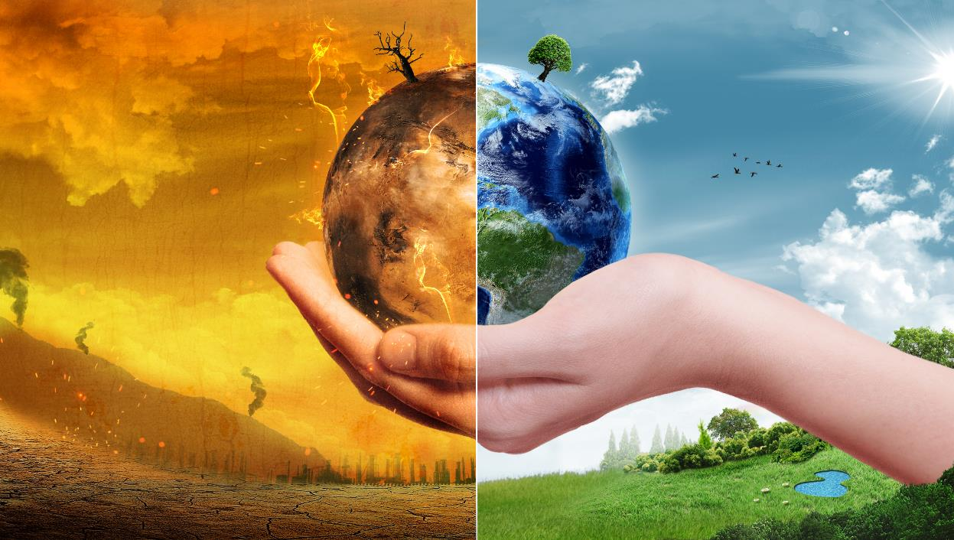
What have you learned?
#THYMEtochange
Notes:
In reality, there is no one clear answer or winner. Truth is, there’s credible arguments both for and against the Bioeconomy. It won’t solve everything, but if done in a sustainable manner, its one step closer to a healthier, happier world.
Encourage students to input suggestions about what they can do. We recognise that what students can and cannot do in reference to this is wholly down to their backgrounds and circumstances. Encourage students by letting them know that small actions collectively can make big differences, and that it isn’t about being perfect – its about trying!
Here are some suggestions if students get stuck.
Take a book from the library to learn more, or research online
Spread the message via social media/posters
Look into the source of my products, and shop more consciously
Make use out of my fruit/veg peelings
Grow my own veg patch
Write to the school and ask them to swap energy providers to a more sustainable one
Reduce amount of fast fashion purchases
Start shopping in charity shops for vintage clothing

Slide 14
And on that note …
What do you think the one important thing you can do is...
Society
Environment
Economy
#THYMEtochange

