Slide 1
Is our school a Bioeconomy?
Lesson 1

Slide 2
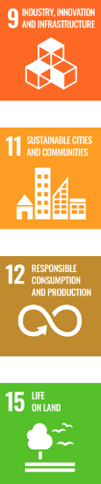
Lesson objectives
Develop and apply geographical fieldwork techniques.
Develop capabilities in presenting and interpreting geographical data. ​
Understand how societies can become more sustainable and move towards a Bioeconomy​.
Interpret data to reach conclusions in relation to complex issues such as sustainability.
Evaluate the limitations of the enquiry​.

Slide 3
Lesson outcomes
Discuss various examples of the Bioeconomy in the context of own environment​.
Be able to critically analyse observations and seek out practical opportunities for the Bioeconomy.
Be able to apply geographical fieldwork techniques to collect data. ​
Be able to analyse and present data in a meaningful and targeted way and use this to make coherent arguments.

Slide 4
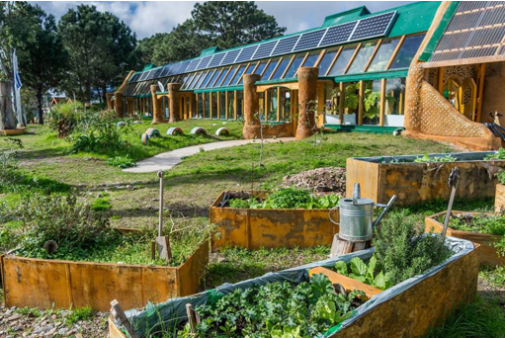
How is this school supporting the Bioeconomy?
Challenge: can you suggest additional features that would support the Bioeconomy?
Notes:
Explain the core aims of the session.
We are going to investigate the Bioeconomy rating of our school site using fieldwork skills.
We will analyse the data collected from our fieldwork to reach conclusions and rate the bioeconomy of our school.
We will suggest a range of strategies to improve the bioeconomy rating of our school.
After introducing the aims and objectives, start by showing the students the image on the slide, asking them to consider how this image is supporting the Bioeconomy. This will allow you to gauge if/how students apply their previous learning to real world scenarios. After a few minutes, encourage students to share their answers with each other and record their answers in the student fieldwork booklet (slide 5) Students should be encouraged to complete the challenge activity, sharing answers with the whole class.

Slide 5
What are the elements of the bioeconomy?
Can we categorise these elements in anyway?
Notes:
Students are asked to think about what makes up the Bioeconomy, they should think about the economy, the people and the environment.
Students may categorise elements of the school site they can see or they might see in a school that supports the Bioeconomy; waste and recycling, transport, green space, energy saving strategies.

Slide 6
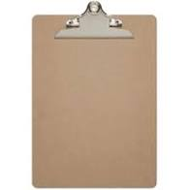
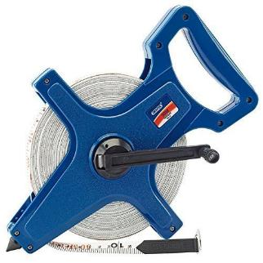
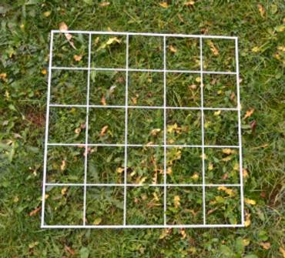
Time to get outside and assess our own premises
Notes:
Introduce or remind students of the names and purpose of the fieldwork equipment that you are going to use. Students should be able to name the equipment, describe how it is used and suggest alternative uses for the equipment.
Discuss health and safety when moving round the school site, potential risks and considerations of carrying out fieldwork whilst other members of the school community are also working.
The FSC has a comprehensive guide to all elements of fieldwork.

Slide 7

Collecting data
Primary data – fieldwork data that you have collected yourself.​
Secondary data – data that another group or organisation has collected.
Can you think of examples of primary and secondary data?​
Record them on your sheet.​
Notes:
Introduce or remind students of the types of data that students will collect; primary and secondary data.
Students can record this information in their fieldwork booklet, plus add examples of primary and secondary data.

Slide 8

Interviews
Arrange to interview a member of your school whose role is to
reduce waste
(electrical, water, heating, food and keep people safe)
What questions can we ask them?​
​
​
​
​
Notes:
Interviews are a form of primary data, students should suggest 5 questions to ask the site business manager or site team to find out about elements of the bioeconomy; waste, transport, green space, energy usage. For example who is the school's energy provider? Is technology recycled once it is no longer in use? Are there energy saving strategies that prevent electricity to be wasted? What are they?
Interviews could be prerecorded and used by more than one class.

Slide 9
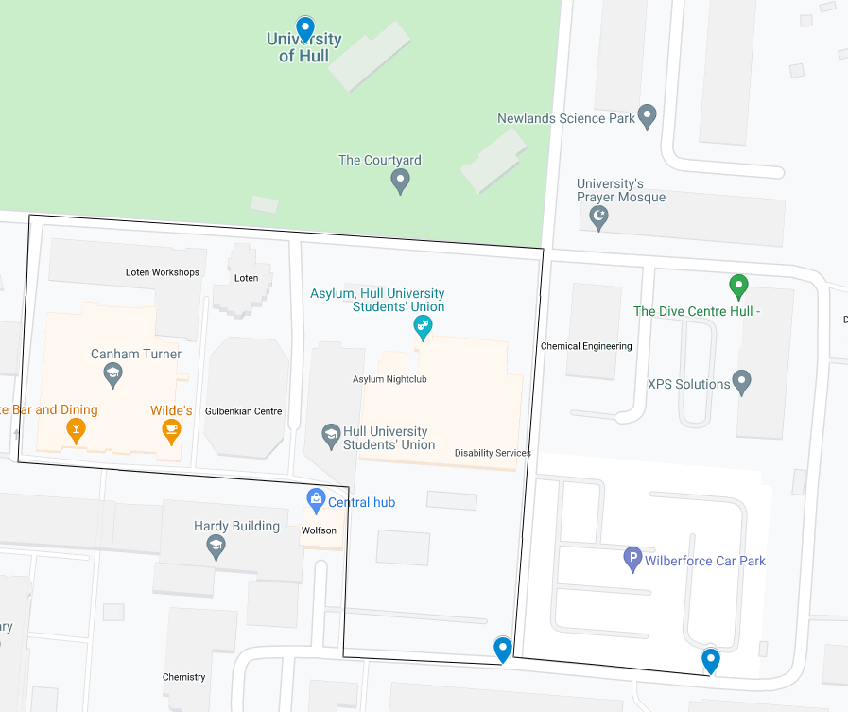
Mapping the Bioeconomy
Design a transect route through your school. ​
Follow the transect.
Plot and tally the following on your route:
Green space​
Ecological variety (add a tally for every new species of plant/animal you see)​
Outside seating made from bio-resource​
Large trees​
Vegetable patch​
Carpark (how many cars, how many empty spaces? ​
Footpaths​
Bike lanes​
Bike storage (in use?)​
Electric car charging point​
Recycling bin (including food waste)​
Posters/signs encouraging waste reduction​
Drink refill station​
Onsite compost bin/wormery​
Renewable energy sources ​
(e.g. solar power)​
Sedum roof (plants)
Notes:
If possible, replace the image with an aerial shot of your premises
Students design a transect/route through the school both inside and out, they should draw it on their copy of the map. The line transect should aim to represent elements of the school grounds, with students carrying out a tally at 4 stations on the route. as an educator you may decide the route to be taken or students may decide their own route. This should be plotted on the map of the school site. In the field students should tally the elements of the bioeconomy they observe.
– Explain the differences between Bioeconomy and sustainability. Guide discussion to remind them that sustainability doesn’t necessarily mean Bioeconomy and vice versa. Ask students to consider if/how those listed contribute to sustainability and the Bioeconomy.
We recommend staying outside to feedback, allowing groups to fill in and cross reference amongst each other, until they have all zones completed on their sheet.

Slide 10
Tally Chart – tally evidence at each sampling point
​ | Sample point 1​ | Sample point 2​ | Sample point 3​ | Sample point 4 ​ | Total Tally​
Green space rating​ | ​ | ​ | ​ | ​ | ​
Green space ​ | ​ | ​ | ​ | ​ | ​
Ecological Variety ​ | ​ | ​ | ​ | ​ | ​
Outside seating made from bio-material​ | ​ | ​ | ​ | ​ | ​
Large trees​ | ​ | ​ | ​ | ​ | ​
Vegetable patch​ | ​ | ​ | ​ | ​ | ​
Transport​ | ​ | ​ | ​ | ​ | ​
Carpark (how many cars, how many empty spaces?)​ | ​ | ​ | ​ | ​ | ​
Footpaths ​ | ​ | ​ | ​ | ​ | ​
Bike lanes​ | ​ | ​ | ​ | ​ | ​
Bike storage​ | ​ | ​ | ​ | ​ | ​
Electric car charging points ​ | ​ | ​ | ​ | ​ | ​
Reducing waste​ | ​ | ​ | ​ | ​ | ​
Recycling bins, including food waste​ | ​ | ​ | ​ | ​ | ​
Posters/signage encouraging waste reduction​ | ​ | ​ | ​ | ​ | ​
Drinks refill station​ | ​ | ​ | ​ | ​ | ​
Onsite composting/wormery​ | ​ | ​ | ​ | ​ | ​
Energy – Reducing fossil fuel consumption​ | ​ | ​ | ​ | ​ | ​
Renewable energy sources on site​ | ​ | ​ | ​ | ​ | ​
Sedum roof - insulation​ | ​ | ​ | ​ | ​ | ​
Notes:
Students to walk their transect, observing elements of the tally chart as they go. At station 1 they should tally the elements that they can observe. Encourage students to really observe their surroundings and make the connection between what they can see and the Bioeconomy.
Once the transect is complete students should total each sample points.

Slide 11
The Bioeconomy Index​
Turning observations into assessments
Notes:
For the next fours slides, students will use the collated tallies and their personal judgements to inform the following Bioeconomy index

Slide 12
Green space rating
​ | -4​ | -3​ | -2​ | -1​ | 0​ | 1​ | 2​ | 3​ | 4​
Area of green space (% cover)​ | ​ | ​ | ​ | ​ | ​ | ​ | ​ | ​ | ​
Ecological Variety​ | ​ | ​ | ​ | ​ | ​ | ​ | ​ | ​ | ​
Outside seating​ | ​ | ​ | ​ | ​ | ​ | ​ | ​ | ​ | ​
Outside play/sports​ | ​ | ​ | ​ | ​ | ​ | ​ | ​ | ​ | ​
Vegetable patch​ | ​ | ​ | ​ | ​ | ​ | ​ | ​ | ​ | ​
Gardening club​ | ​ | ​ | ​ | ​ | ​ | ​ | ​ | ​ | ​
Subtotal out of 20
As a percentage | %
Notes:
Qualitative research method uses scales so that responses can be put into rank order. Green space rating is a bi-polar analysis of elements of the bioeconomy. Students should be encouraged not to score a space as 0, they should aim to use the range of ratings available. A bi-polar rating allows students to rate elements as negative and positive scorings.
The Green space rating is out of 20, this should then be converted into a percentage, allowing each of the elements to be easily compared. Each element is scored out of 20, then converted into a percentage to be used later in the data analysis section of the fieldwork.

Slide 13
Transport
​ | -4​ | -3​ | -2​ | -1​ | 0​ | 1​ | 2​ | 3​ | 4​
Full carpark (less cars = higher score)​ | ​ | ​ | ​ | ​ | ​ | ​ | ​ | ​ | ​
Footpaths and crossings to promote walking​ | ​ | ​ | ​ | ​ | ​ | ​ | ​ | ​ | ​
Bike lanes​ | ​ | ​ | ​ | ​ | ​ | ​ | ​ | ​ | ​
Bike storage​ | ​ | ​ | ​ | ​ | ​ | ​ | ​ | ​ | ​
Electric car charging points​ | ​ | ​ | ​ | ​ | ​ | ​ | ​ | ​ | ​
Locally sourced food and supplies (to reduce carbon footprint)​ | ​ | ​ | ​ | ​ | ​ | ​ | ​ | ​ | ​
Subtotal out of 20
As a percentage | %
Notes:
Students use their observations to calculate their ratings of the four areas of the school site; green space, transport, reducing waste and energy rating. The bipolar scale asks students to make their ratings between two opposite end points, each element if scored out of 20, then converted to a percentage to be used in the data analysis section of the fieldwork.

Slide 14
Reducing waste
​ | -4​ | -3​ | -2​ | -1​ | 0​ | 1​ | 2​ | 3​ | 4​
Recycling bins, including food waste​ | ​ | ​ | ​ | ​ | ​ | ​ | ​ | ​ | ​
Posters/signage encouraging waste reduction​ | ​ | ​ | ​ | ​ | ​ | ​ | ​ | ​ | ​
Reusable plates & cutlery​ | ​ | ​ | ​ | ​ | ​ | ​ | ​ | ​ | ​
Drinks refill available​ | ​ | ​ | ​ | ​ | ​ | ​ | ​ | ​ | ​
Onsite composting/wormery​ | ​ | ​ | ​ | ​ | ​ | ​ | ​ | ​ | ​
Use of scrap paper​ | ​ | ​ | ​ | ​ | ​ | ​ | ​ | ​ | ​
As a percentage | %
Subtotal out of 20
As a percentage | %
Notes:
Question Prompts:
How could we repurpose our food waste? A compost heap would turn it into organic compost

Slide 15
Energy – Reducing Fossil Fuel Consumption
​ | -4​ | -3​ | -2​ | -1​ | 0​ | 1​ | 2​ | 3​ | 4​
Light sensors​ | ​ | ​ | ​ | ​ | ​ | ​ | ​ | ​ | ​
Energy saving lightbulbs​ | ​ | ​ | ​ | ​ | ​ | ​ | ​ | ​ | ​
Renewable energy sources on site​ | ​ | ​ | ​ | ​ | ​ | ​ | ​ | ​ | ​
Renewable energy provider ​ | ​ | ​ | ​ | ​ | ​ | ​ | ​ | ​ | ​
Power down PCs/unplug electronics​ | ​ | ​ | ​ | ​ | ​ | ​ | ​ | ​ | ​
Sedum roof - insulation​ | ​ | ​ | ​ | ​ | ​ | ​ | ​ | ​ | ​
Subtotal out of 20
As a percentage | %

Slide 16
What is your overall Bioeconomy rating?
100%
Extremely Sustainable
90%
Very Sustainable
70%
Fairly Sustainable
50%
Partially Sustainable
30%
Bioeconomy is a concern
Percentage calculation:
(Total ÷ 80) x 100
20%
Very low evidence of the Bioeconomy
Notes:
Total the 4 elements to calculate the school's overall Bioeconomy rating.

Slide 17
Present your findings
Pie Chart
Presenting your research findings is an important skill. What ways can we present the data found?
Horizontal Bar chart
Scatter graph
Think!
What data will you present?
How will you use the data?
Who will you show it to?
Will you present each zone/category separately?
Make sure you can justify your choices
Line graph
Notes:
Suggest possible methods of appropriate data presentation methods, use the questions to determine the data presentation that will be used.
The questions provide an opportunity to discuss the appropriate data presentation technique and discover the strengths and weaknesses of data presentation methods and justify choice of data presentation techniques.
Can students think of any other ideas to replace the question marks? Will they present both numerical and textual data (quantitative and qualitative)? The second is particularly relevant if they interviewed/sent questionnaires to find supplementary data.
On the second question in particular “How will you use the data?” encourage students top consider what they want to achieve by making the data understandable. What is the point of presenting data in these formats?
Will presenting this data make it easier for students to identify gaps and possible solutions? Will it help to make more informed choices and move towards a more sustainable school?
Could the students use the data to highlight gaps to SLT at school?

Slide 18
Example: Data presentation on a horizontal bar chart
Green Space
Transport
Waste
Energy and Fossil Fuel
(each block represents 6 points, or 25%)
Notes:
Using the percentages calculated in slides 12-15 to plot an appropriate graph to represent the data. A horizontal bar chart is suggested. Students should give the graph an appropriate title and label the axis.
Slide 18 & 19 provide an example of a data presentation method; a horizonal bar graph, students may select an alternative data presentation method. The student booklet contains a blankoutline of the horizontal bar chart, students could produce their own graph.

Slide 19
Example: Data presentation on a vertical bar chart
​ | ​ | ​ | ​
​ | ​ | ​ | ​
​ | ​ | ​ | ​
​ | ​ | ​ | ​
(each block represents 6 points, or 25%) ​
Green Space
Transport
Waste
Energy & Fossil Fuel

Slide 20
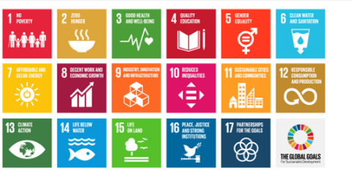
Writing a good conclusion
What does your data show?​
Which area of your school supports the Bioeconomy the most?​ What is its Bioeconomy index rating?
Which area of your school has the fewest elements of the Bioeconomy?​ What does it score on the Bioeconomy Index?
3.Describe the element that supports the Bioeconomy the most. ​
4. Explain how this element supports the Bioeconomy the most.
Challenge: What could be done to improve the Bioeconomy rating of your school? ​
Remember the SDGs? Can you link them to any of your findings?
Notes:
Students should use the data to write a conclusion to the fieldwork question. The conclusion incorporates data interpretation and knowledge of the Bioeconomy. Students should be encouraged to manipulate the data to produce a more sophisticated analysis.
The challenge activity asks students to reflect and suggest how the Bioeconomy rating of the school can be improved, thinking about the SDGs.

Slide 21
What might have affected your results?…
What part of the fieldwork design caused errors to be introduced?
How could these problems have changed your results and changed your conclusion?
What geographical knowledge have I gained from carrying out this investigation?
Challenge: If you were going to repeat the investigation how will you make the results more reliable?
Notes:
This section allows students to evaluate the fieldwork method and make suggestions on how the suggested changes can improve the accuracy and variety of data collection.
Key terms – true value is the value that would be obtained in an ideal measurement.
Accuracy means how close a measurement is to the true value.
Measurement error – mistakes made when collecting the data.
Anomalies are values in a set of results which are judged not to be part of the variation caused by random uncertainty.
Be objective – think about frequency and timings
Be critical – have you chosen the best method, were you accurate and precise?
Be ethical – how did you avoid damaging the environment? How did you avoid causing offence or a nuisance? Did you have consent to carry out observations?
Students should go back through each one of their fieldwork methods and consider the following points:
How accurate were the results?
What were the sources of error? Measurement error, operator error, sampling error, validity.
How has each source of error affected your results?

Slide 22
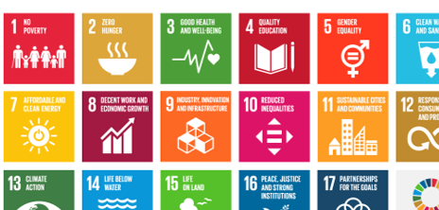
How do your results affect your understanding of the Bioeconomy?
What is the Bioeconomy?
Why is it important to use the planets resources responsibly?
Explain how local action, for example by schools, can support a circular economy minimising waste and pollution and reducing damages from economic activities.
Notes:
What is the knowledge that we want students to know about the Bioeconomy? What are the different elements of the Bioeconomy? How does that link to our school?

