Slide 1
What is the Bioeconomy?
Lesson 2

Slide 2
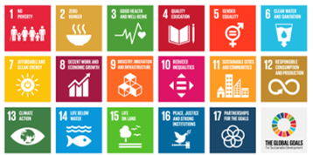
Lesson objectives
Recognise how sustainable development can be supported by elements of the Bioeconomy.
Examine how the Sustainable Development Goals (SDGs) are interrelated and how they underpin one another.
Analyse personal consumption practices and behaviours in relation to the SDGs.

Slide 3
Lesson outcomes
Discuss the term sustainability, in relation to society, environment and economy.
Categorise the SDGs and identify the links between them.
Rank the SDGs in order of priority and provide justification for choices.
Suggest how the bioeconomy can help achieve the SDGs explored.

Slide 4
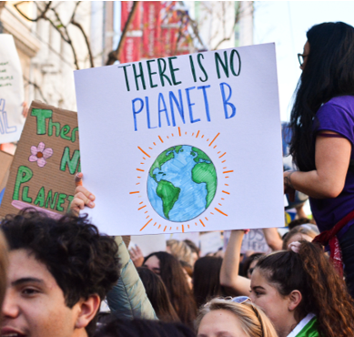
Think back to last lesson, read this statement and suggest what we mean by sustainability in relation to the economy.
“Sustainability is meeting the needs of the present without compromising the ability of future generations to meet their own needs.”
The Brundtland report, 1987
Notes:
Ask students to define sustainability in relation to the economy, based on their existing knowledge. Encourage students to use the key vocabulary - Economy, Environment and Society. Can both exist together economic development and sustainability? Does there have to be a compromise, if so which factor will suffer, the economy or the environment?

Slide 5
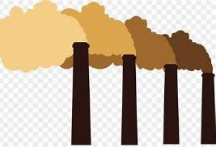
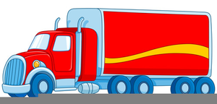
What is sustainability within our economy? (and what is it not?)
Economy
Challenge: What impact does this have on people and the environment?
Hint:
Notes:
Students brainstorm what is sustainable in our economy and what is not? The images at the bottom of the slide can be used as prompts (transport, clothing, packaging, energy production) the challenge question asks students, what impact does this have on people and the environment?

Slide 6
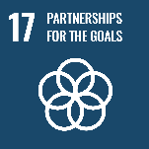
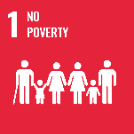
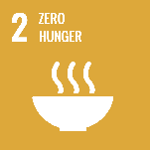
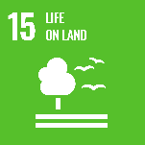
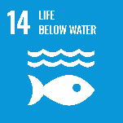
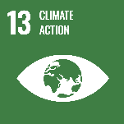
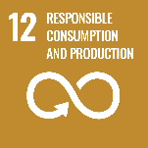
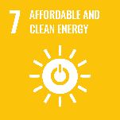
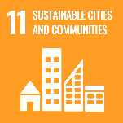
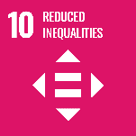
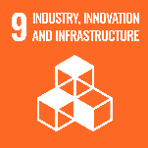
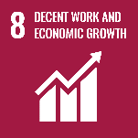
Society
Economy
Environment
Notes:
Teacher guidance:
Ask students if they recognise the square images.
These are the UN Sustainable Development Goals 2030 (SDGs). “The 2030 Agenda for Sustainable Development, adopted by all United Nations Member States in 2015, provides a shared blueprint for peace and prosperity for people and the planet, now and into the future. At its heart are the 17 Sustainable Development Goals (SDGs), which are an urgent call for action by all countries - developed and developing - in a global partnership. They recognize that ending poverty and other deprivations must go hand-in-hand with strategies that improve health and education, reduce inequality, and spur economic growth – all while tackling climate change and working to preserve our oceans and forests.” (UN, 2021). (there exists a wealth of resources online https://sdgs.un.org/goals that aim to teach the SDGs. Any further lessons on this would compliment these packs.
Ask students:
1) Match each SDG to one of the pillars of sustainability – Society, Environment, and Economy.
Guide discussions to conclude that many of the SDGs overlap with each other and do not fit neatly into one of the three outlined categories. E.g. no poverty depends on a healthy environment that can provide food and water, as well as enough jobs for people to work. People lose their income when climate change causes drought and flooding – both in low income countries and high income countries. The sustainable development of the Earth depends on a healthy environment to provide food, resources and water. An economy cannot be maintained by an unhealthy society who do not have access to these, or who have run out of those necessary.
2) What are humans currently doing that prevents us from meeting these goals?
Encourage students to critically examine their own behaviours, as well as that of society as a whole, businesses and world-leaders. Can they find solutions to overcome these barriers?

Slide 7
Let's take a closer look…
Case study
Research how a variety of products are supporting economic development, people and the environment.
Notes:
The following section looks at a case study, it can be carried out as individual/group research to further students learning. ​
There are corresponding print outs for students to use in the KS4 Pack 1 Teachers guidance and lesson plans (pages 20 to 27).
These can be explored as the teacher/ educator sees fit, but we suggest breaking the class up into small groups, assigning each group a case study. Students can then be given an allocated amount of time to investigate the case study, and use online sources to inform a presentation about that specific topic in relation to the Bioeconomy. There are question hints on the print outs. ​
The case study asks students to research how the products are supporting economic development, people and the environment.

Slide 8
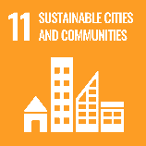
How can the Bioeconomy support the SDGs?
Place one SDG in each hexagon, then explain the link in relation to the question. Make a chain of as many SDGs as you can to answer the key question. Use your case study to support your answer.
The bioeconomy uses resources that are natural and easily renewed.
Resources are renewable and are not wasted.
This requires businesses to think outside the box.
Reduces waste and pollution and allows businesses to be economically successful.
Notes:
Plenary
Using the SDGs students make a linking diagram to explain how the Bioeconomy can support the SDGs. Students should include a economic, social & environmental SDG in their explanation.
Students aim to answer the key question linking hexagons together, each hexagon should have a SDG and a brief explanation. Students may produce a series of hexagon chains or they may wish to create links coming from a particular SDG.

