Slide 1
Will we ever run out?
Lesson 1
Notes:
Refer to KS4 Resource Pack 1 – Will we ever run out? for further guidance and dialogue.

Slide 2
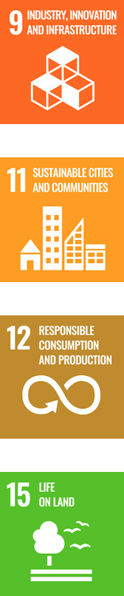
Lesson objectives
Identify which of the Earth’s resources are renewable and non-renewable.
Classify resources by their renewal times.
Understand that living (bio-based) resources can offer a more sustainable economic model: The Bioeconomy
Define the term Bioeconomy

Slide 3
Lesson outcomes
Explore where the Earth’s resources are created and suggest why some resources are limited.
Define the term Bioeconomy and suggest how it supports the sustainable use of resources.
Demonstrate how businesses can continue to use the Earth’s resources.

Slide 4
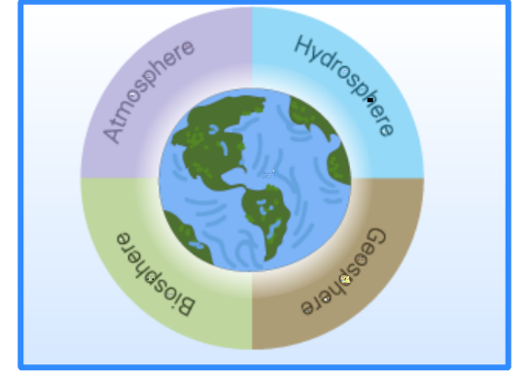
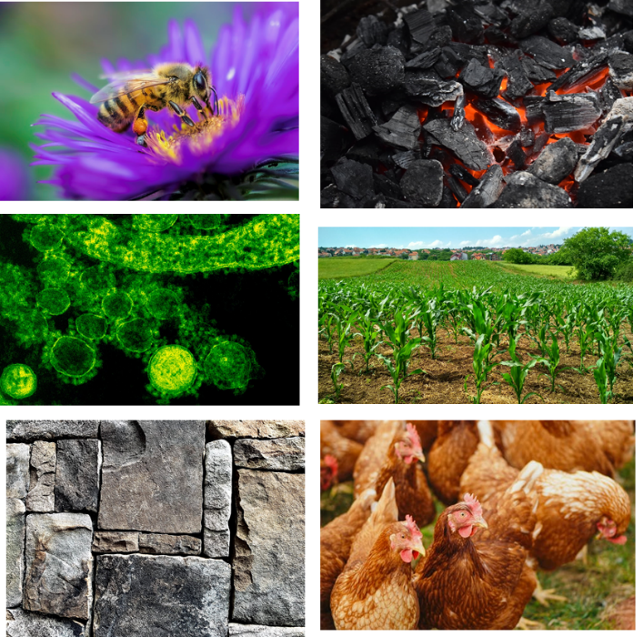
Link the resource to the Earth’s sphere responsible for its production.
1
2
3
4
5
6
Activity: Which spheres are responsible for producing the largest number of our resources?
Suggest reasons for this.
Challenge: Is it possible for more than one sphere to be responsible for the generation of resources?
Notes:
Students may need reminding on the role of the 4 spheres before completing this activity. Students may identify the main sphere responsible for the generation of resources, some may suggest that the input from the atmosphere and hydrosphere is essential for the development of all resources.

Slide 5
Link the resource to the Earth’s sphere responsible for its production.
1
2
3
4
1
2
4
5
5
6
6
Activity: Which spheres are responsible for producing the largest number of our resources?
Suggest reasons for this.
Challenge: Is it possible for more than one sphere to be responsible for the generation of resources?
Answers
Notes:
Students may need reminding on the role of the 4 spheres before completing this activity. Students may identify the main sphere responsible for the generation of resources, some may suggest that the input from the atmosphere and hydrosphere is essential for the development of all resources.

Slide 6
Do now:
Read the statement.
Define the meaning of the phrase ‘limited resources’ within this context.
Challenge: Suggest how businesses can use limited resources and still be economically productive.
“Many powerful people in business believe that there is a new challenge in the 21st century: a strong business will be one that can be successful in a world of limited resources. The competitive advantage will be with those who can think outside of the box.”
Janez Potocnik (2013)
Towards the Circular Economy,
Ellen MacArthur Foundation
Notes:
Introduce the idea that resources are limited and will become more so as we continue to develop economies across the globe. Students should start to suggest innovative ways that businesses can use the Earth's resources and still be productive. Students may begin to discuss renewable and non-renewable resources, the most economically successful businesses will rely on renewable resources. The Bioeconomy looks to use biobased resources to make products of the highest added value in a sustainable way.

Slide 7
Bioeconomy
The Bioeconomy could have the answers...
What do you think this word means?
Hint: Try splitting the word into two familiar sounding parts.
Notes:
Students use their literacy skills to split the word into bio and economy, define them individually, then put the 2 parts together, what do they think the Bioeconomy is?
The Bioeconomy, or biobased economy, is a new model for industry and the economy. It involves using renewable biological resources sustainably to produce food, energy and industrial goods.

Slide 8

The Bioeconomy
Notes:
Watch the clip and complete the table on the following slide. Encourage students to record data and specific information.

Slide 9
Complete this table in pairs while you watch the clip
Facts
Examples
Definition: The Bioeconomy is...
Why is the Bioeconomy important?
What do you think? Is it achievable? A good solution?
Notes:
This table is available in the KS4 Pack 1 word document as Lesson 1 Activity Sheet A on page 14. It is suggested that the graphic organiser can be in pairs, as the clip contains lots of useful information, encourage students to included data and specific key information. Once the clip has finished students should be given time to reflect on the information collected before completing the definition of the Bioeconomy. The Bioeconomy is an economy is an economy based on renewable biological resources. These resources maybe converted into food, bio-based products or bioenergy.

Slide 10
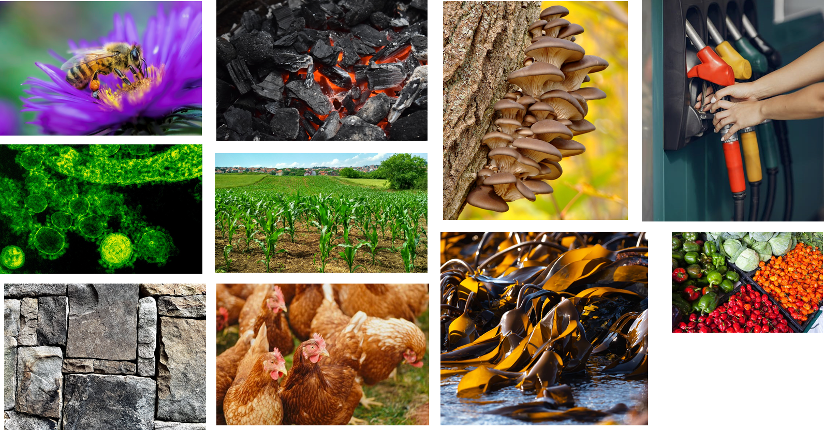
Name each of the resources and suggest at least one example of a product made from each. Complete the table with your answers to explain how businesses are using the Earth’s resources.
1
2
3
4
5
6
9
10
7
8
Notes:
Students use a print out of slide 11 and the images on slide 10 to identify a range of biobased resources and list economic uses, students link their knowledge of these products and rank them in order of the time taken to renew them within their sphere of the earth. Students can check their answers on slide 12.

Slide 11
How do businesses use the Earth’s resources?
 | Name of resource | Economic uses | Renewal ranking (1- 10)
1
2
3
4
5
6
7
8
9
10
Are there any bio-based resources missing from this list?
Notes:
This table is available to print from the KS4 Pack 1 document as Lesson 1 Activity Sheet B on page 15. Using the images of biobased resources students are asked to complete the table on slide 11, name the resource, economic use(s) then rank the renewal time (1 – fastest renewal time, 10-longest renewal time) The challenge question asks students to think beyond the suggested biobased resources on slide 10 and suggest other biobased resources. These resources can be linked to any of the Earth's spheres.

Slide 12
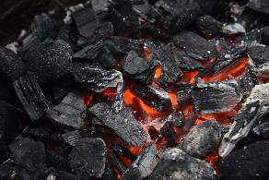
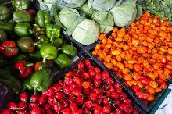
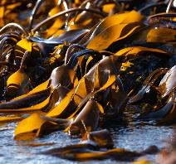
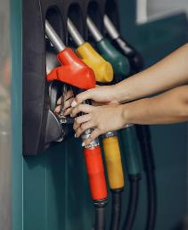
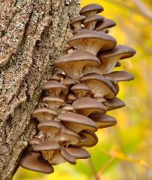
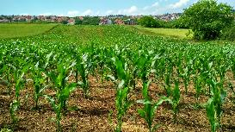

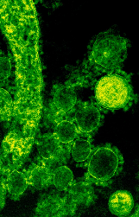
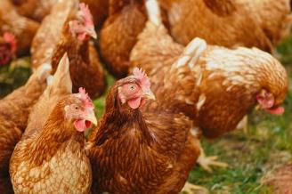
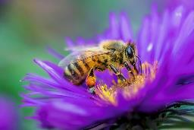
Check your rankings
~300 million years ago
Seasonally Monthly Daily
Can you suggest any issues with these renewal rates?
Notes:
This graphic can be used to check the ranking of renewal rates. The question asks students to think about the economic issues with renewal rates of biobased resources (feeding the population, for transport, for energy production) Can we sustain our current use of these products and conitnue to develop economically?

Slide 13
Can businesses continue to use the Earth’s resources?
Sentence starters:
I think that the Earth will not run out of resources because …
or
I think that the Earth will run out of resources because …
Success Criteria:
Use your rankings
Use your timeline
Use the source materials
Write a short paragraph
Use the challenge words
Challenge words:
non- renewable renewable sustainable
non-sustainable economy fossil fuels
replace linear bio-resource
circular organic
Notes:
Students can answer the question use one of the sentence starters to begin their paragraph, encourage students to follow the success criteria to produce a detailed answer to the question. Students may find the Exposure Vocabulary Grid to support their writing.

Slide 14
What about plastic?
Notes:
Is a video that explains the journey of plastic, from fossil fuel to plastic and marine litter. Plastic originates from a bio-based product, but is currently not used in a sustainable economic or environmental way. Discuss how students feel about this. How does this fit with our definition of the Bioeconomy? The Bioeconomy is an economy is an economy based on renewable biological resources. These resources maybe converted into food, bio-based products or bioenergy. Should we continue to use plastic?

Slide 15
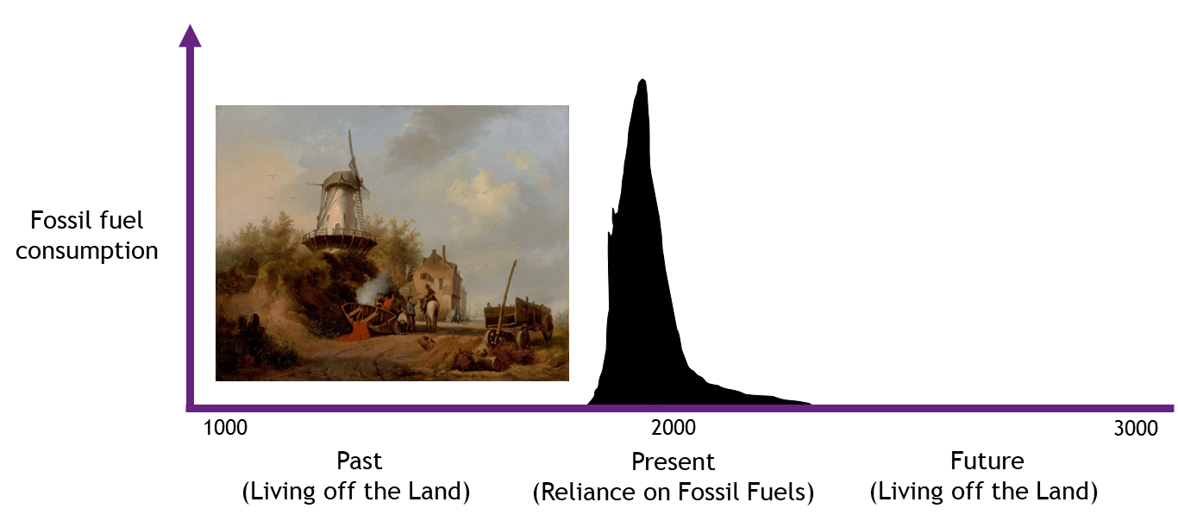
Humans have become very reliant on crude oil for products and energy … but as we have discovered, they will eventually run out! Also, when we use and process crude oil and other fossil fuels, it releases CO2 into the atmosphere, which contributes towards climate change. It is essential we find alternative ways of making products and services that don’t rely on fossil fuels, whilst reducing our overall consumption!
1. What does this graph tell us about our use of fossil fuels in the past, present and future?
2. When does our use of fossil fuel decline? Suggest reasons for this.
3. Suggest what we are using to replace fossil fuel usage.
Notes:
Students analyse the graph to summarise using data our use of fossil fuels in the past, present and the future. Students suggest when our use of fossil fuels declines and possible reasons for this. What do students think is going to replace fossil fuels?

Slide 16
Finally …
“Many powerful people in business believe that there is a new challenge in the 21st century: a strong business will be one that can be successful in a world of limited resources. The competitive advantage will be with those who can think outside of the box.”
Janez Potocnik (2013)
Towards the Circular Economy,
Ellen MacArthur Foundation
We started by reading this statement. Read what you originally wrote. Has your answer and understanding changed? And …
Will we ever run out?
Notes:
Plenary: Ask students to reflect on their answer to the earlier activity responding to the quote. Has their answer changed? Do they have the same answer but have a greater understanding of the reasons for their answer? Can students now add further key vocabulary to their glossary and/or their answer to the starter activity?
Finally make a prediction based on this knowledge. Will we ever run out of resources? This could be biobased or non-biobased resources. Encourage students to differentiate between the two.

