Slide 1
Is our school a Bioeconomy?
Pack 2: The Lesson

Slide 2





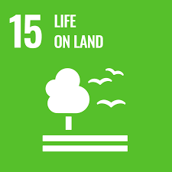



Lesson Objectives
Develop and apply geographical fieldwork techniques
Develop capabilities in presenting geographical data
Understand how societies can become more sustainable and move towards a Bioeconomy
Develop decision making and debate competencies, particularly in relation to complex issues such as sustainability

Slide 3
Lesson Outcomes
Discuss various examples of the Bioeconomy in the context of own environment
Be able to critically analyse observations, and seek out practical opportunities for the Bioeconomy
Be able to apply geographical fieldwork techniques to collect data
Be able to analyse and present data in a meaningful and targeted way, and use this to make coherent arguments

Slide 4
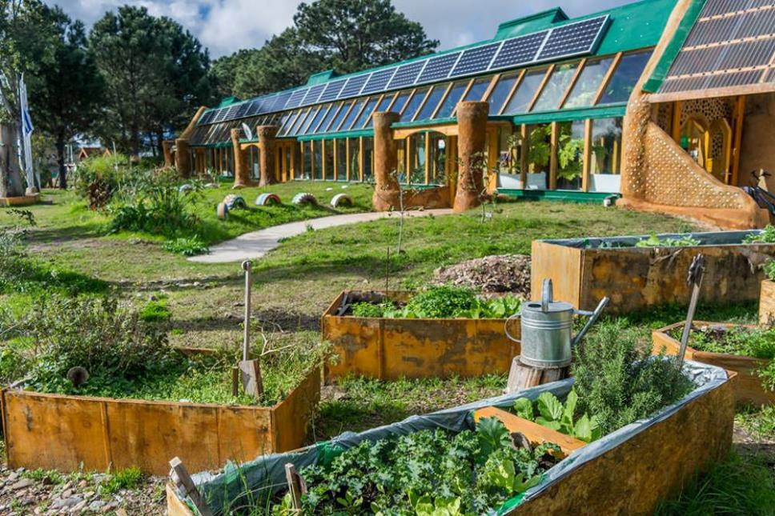
How is this school supporting the Bioeconomy?
Challenge: Can you suggest additional features that would support the Bioeconomy?

Slide 5

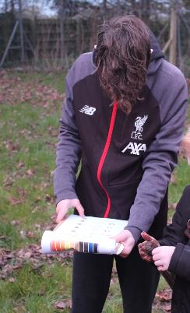
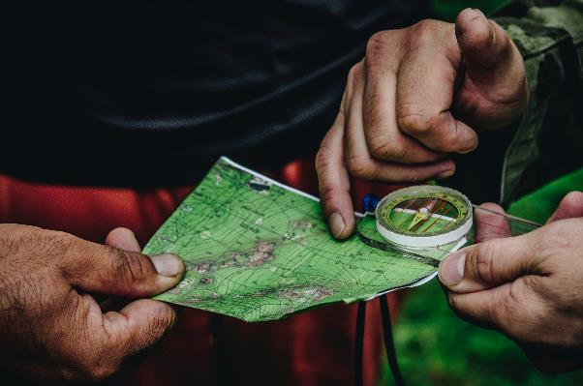
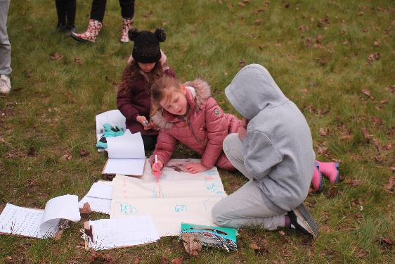
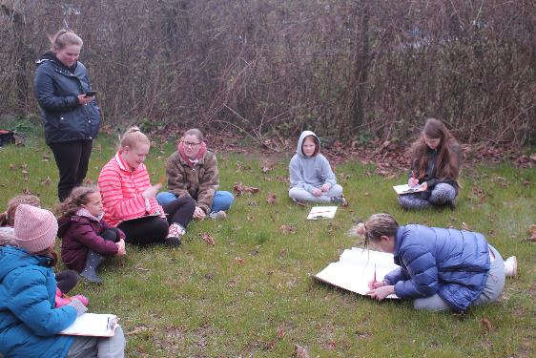
Time to get outside and assess our own premises
Notes:
Explain to students the core aims of the session:
We are going to investigate the Bioeconomy rating of our school site using a range of fieldwork skills.
We will analyse the data collected from our site survey to reach conclusions and rate the Bioeconomy status of our school.
We will suggest a range of strategies to increase the Bioeconomy rating of our school

Slide 6
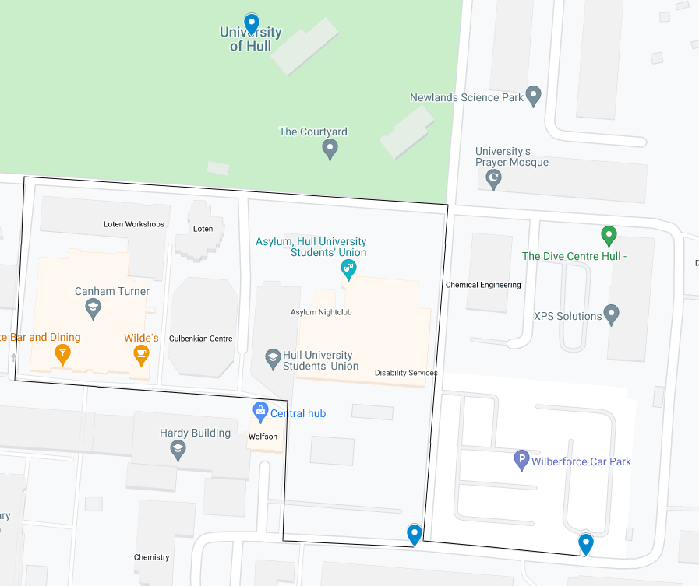
Mapping the Bioeconomy
You’ll be doing similar work to an Environmental Quality Officer today!
Design a transect route through your school (see the example below of the University of Hull Campus!)
Follow the transect.
Plot and tally the following on your route:
Green space
Ecological variety (add a tally for every new species of plant/animal you see)
Outside seating made from bio-resource
Large trees
Vegetable patch
Carpark (how many cars, how many empty spaces?
Footpaths
Bike lanes
Bike storage (in use?)
Electric car charging point
Recycling bin (including food waste)
Posters/signs encouraging waste reduction
Drink refill station
Onsite compost bin/wormery
Renewable energy sources
(e.g. solar power)
Sedum roof (plants)
Record anything else you think is relevant too
Notes:
Teacher guidance
If possible, replace the image with an aerial shot of your premises
– Explain the differences between Bioeconomy and sustainability. Guide discussion to remind them that sustainability doesn’t necessarily mean Bioeconomy and vice versa. Ask students to consider if/how those listed contribute to sustainability and the Bioeconomy.
You might chose to replace the image above with a google map screenshot / alternative birds eye view of your premises.
Divide the class into groups of your choosing. Divide the map into as many sections as there is groups. Ask each group to plot a transect walk through their zone. Alternatively, allow them to explore their zone without a transect walk. Students can then plot and tally those things they see on the list above within their zone. A print out for this is in slide 7 and Page 13 in the main handout.
We recommend staying outside to feedback, allowing groups to fill in and cross reference amongst each other, until they have all zones completed on their sheet.

Slide 7
Tally Chart
 | Transect 1 | Transect 2 | Transect 3 | Transect 4 | Total Tally
Green space rating
Green space
Ecological Variety
Outside seating made from bio-material
Large trees
Vegetable patch
Transport
Carpark (how many cars, how many empty spaces?)
Footpaths
Bike lanes
Bike storage
Electric car charging points
Reducing waste
Recycling bins, including food waste
Posters/signage encouraging waste reduction
Drinks refill station
Onsite composting/wormery
Energy – Reducing fossil fuel consumption
Renewable energy sources on site
Sedum roof - insulation
Notes:
Add columns as necessary to represent the number of transects/groups.
We recommend staying outside to do this, and printing off the worksheets for students to fill in and cross reference amongst each other.

Slide 8
The Bioeconomy Index
Turning observations into assessments
Notes:
For the next fours slides, students will use the collated tallies and their personal judgements to inform the following Bioeconomy index – A print out is available on Page 14 of the main handout.

Slide 9
Green Space Rating
 | -4 | -3 | -2 | -1 | 0 | 1 | 2 | 3 | 4
Area of green space (% cover)
Ecological Variety
Outside seating
Outside play/sports
Vegetable patch
Gardening club
Subtotal out of 24
As a percentage |  |  | %
Notes:
Guidance: This is a bipolar scale that allows for both a negative and positive assessment. 0 represents neither good nor bad. 4 is as good as it could possibly be, whilst -4 represents the opposite. Once completed, students add up each section, and record this in the subtotal. Finally, students will total these 4 areas up to get their Bioeconomy Index Rating out of 96. Challenge: students turn this into a percentage.
This task allows students to turn data into useful measurements, whilst still applying their own judgement. It will encourage them to think critically about the everyday practices of their school/home/themselves/society in general. Students should be encouraged by telling them that there is no right or wrong answer to this, however it is important that students first consider what each point on the scale looks like.
Students will likely notice there are more areas to rate on this than what they were asked to look for on the tally chart. Prompt students to consider how they might collect data to answer these. E.g. using personal knowledge, or designing a questionnaire/interview for staff/students/head teacher/school cook etc. Perhaps further observations inside the school building need to take place. Support students to do this. You might want to have a few members of staff on standby ready to be interviewed, or have the answers yourself.
Question Prompts:
Q. Why might ecological variety be important to the Bioeconomy? A: Ecological variety is important in sustaining ecosystems. We need a variety of plants, insects and animals in order to maintain life. It is important we have bees and other pollinators for the growth of our food and other biobased resources. Ecological variety is essential for sustainable development.
Q: Why might outside play areas be important for the Bioeconomy? A. Encouraging play in and with nature/outdoors is essential in getting people to protect it. We’ve explored how nature is critical to sustaining human life and the Bioeconomy. But if people don’t care for and respect it, it will go unprotected.
Q: Which of these do you feel is most important? Do they all have equal levels of importance? A: This is completely subjective. There is no right and wrong, and should be used to facilitate classroom debate

Slide 10
Transport
 | -4 | -3 | -2 | -1 | 0 | 1 | 2 | 3 | 4
Full carpark (less cars = higher score)
Footpaths and crossings to promote walking
Bike lanes
Bike storage
Electric car charging points
Locally sourced food and supplies (to reduce carbon footprint)
Subtotal out of 24
As a percentage |  |  | %
Notes:
Question prompts:
What does it mean by Locally sourced food and supplies, and how does this relate to the Bioeconomy? This could lead to conversations about air miles, and where we get our food/other bio-based resources from. Is it sustainable for example, for us in the UK to make things from bamboo that has been grown in Asia? Is it ok that on average, a watermelon travels 4122 miles before it is consumed? Check out https://www.foodmiles.com/ for quick stats about certain produce.

Slide 11
Reducing Waste
 | -4 | -3 | -2 | -1 | 0 | 1 | 2 | 3 | 4
Recycling bins, including food waste
Posters/signage encouraging waste reduction
Reusable plates & cutlery
Drinks refill available
Onsite composting/wormery
Use of scrap paper
Subtotal out of 24
As a percentage |  |  | %
Notes:
Question Prompts:
How could we repurpose our food waste? A compost heap would turn it into organic compost

Slide 12
Energy – Reducing Fossil Fuel Consumption
 | -4 | -3 | -2 | -1 | 0 | 1 | 2 | 3 | 4
Light sensors
Energy saving lightbulbs
Renewable energy sources on site
Renewable energy provider
Power down PCs/unplug electronics
Sedum roof - insulation
Subtotal out of 24
As a percentage |  |  | %
Notes:
Question Prompts:
What energy sources are used by the school? Where could we make savings in electricity usage?

Slide 13
What is your overall rating?
100%
90%
70%
50%
Percentage calculation: (Total ÷ 96) x 100
30%
20%
Notes:
Total the 4 elements to calculate the school's overall Bioeconomy rating.

Slide 14
Present your findings
Presenting your research findings is an important skill. What ways can we present the data found?
Think!
What data will you present?
How will you use the data?
Who will you show it to?
Will you present each zone/category separately?
Make sure you can justify your choices
Pie Chart
Word Cloud
Horizontal Bar chart
Scatter graph
Key quotes
???
Notes:
Can students think of any other ideas to replace the question marks? Will they present both numerical and textual data (quantitative and qualitative)? The second is particularly relevant if they interviewed/sent questionnaires to find supplementary data.
On the second question in particular “How will you use the data?” encourage students top consider what they want to achieve by making the data understandable. What is the point of presenting data in these formats?
Will presenting this data make it easier for students to identify gaps and possible solutions? Will it help to make more informed choices and move towards a more sustainable school?
Could the students use the data to highlight gaps to SLT at school?

Slide 15
Example: Data presentation on a vertical bar chart
Green Space
Transport
Waste
Energy and Fossil Fuel
(each block represents 6 points, or 25%)
Notes:
This clearly allows the viewer to see that the location is doing well in green space, but there is huge room for improvement in energy usage. This helps prioritise changes.

Slide 16
Data presentation: Vertical bar chart
Green Space
Transport
Waste
Energy and Fossil Fuel
(each block represents 6 points, or 25%)
Notes:
Blank one for students if needed

Slide 17
Example: Data Presentation on a Pie Chart

Slide 18
Data Presentation on a Pie Chart
Green Space
Transport
Reducing Waste
Energy

Slide 19
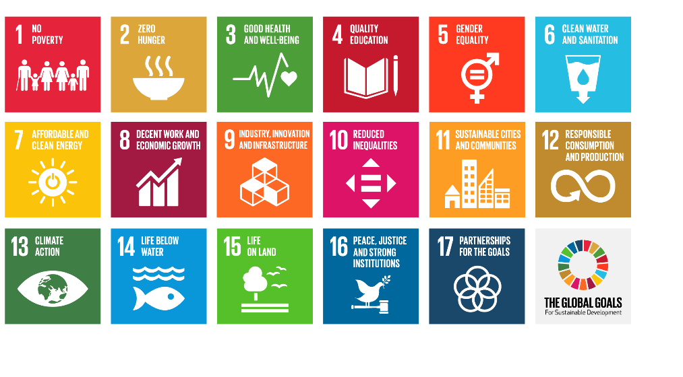
Final thoughts …
What does your data show?
Which area of your school supports the Bioeconomy the most?
Which area of your school has the fewest elements of the Bioeconomy?
Describe the element that supports the Bioeconomy the most.
4. Explain how this element supports the Bioeconomy the most.
Challenge: What could be done to improve the Bioeconomy rating of your school?
Remember the SDGs? Can you link them to any of your findings?
Notes:
Within Pack 2, there are a selection of lesson plans and activities that can improve the bioeconomy of your grounds. You can show students all these options if they need some inspiration. Students could also research ideas online.

