Slide 1
Is it time to bin the plastic bag?
Pack 1: Lesson 3

Slide 2
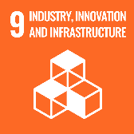
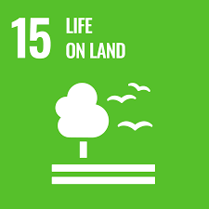
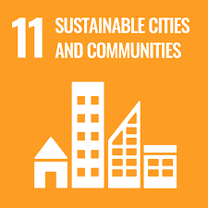
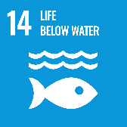
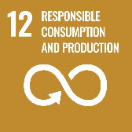
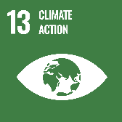
Lesson Objectives
Understand the evolution of plastic throughout history
Understand the pros and cons of plastic to modern society
Apply growing knowledge of sustainability to own practices
Analyse and evaluate the properties of natural and manmade materials, including plastic and biological alternatives
Design and conduct a scientific experiment
Design an innovative alternative to plastic bags
Justify the reasons for own choices.

Slide 3
Lesson Outcomes
Analyse own habits in relation to sustainability
Conduct a scientific experiment that analyses the biodegradability of various resources
Design and conduct a scientific experiment that assesses the properties of various materials
Apply findings of research to design an alternative to the plastic bag.

Slide 4
How achievable is sustainability (locally and globally)? Place your opinion on the line.
Not at all achievable
Extremely achievable
Challenge: What does sustainable mean to you?

Slide 5
Do you only buy/use what you need? Discuss…
What makes you buy something?
How many items do you usually have in your basket?
Could you borrow it from a family member or friend?
What do buy that you don’t really need, but want?
Do you repair clothes if they get a hole in them?
Do you have a refillable drinks bottle? Do you use it? Do you have more than 1?
Are you buying it for one occasion? What will you do with it afterwards?
Do you ask fast food and takeaway restaurants to not give you plastic cutlery?

Slide 6
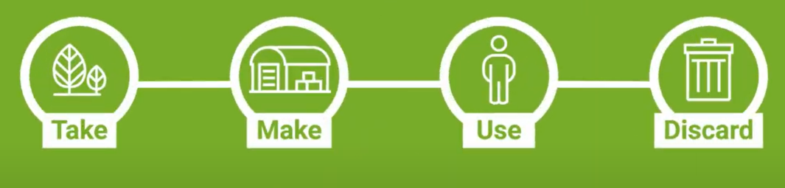
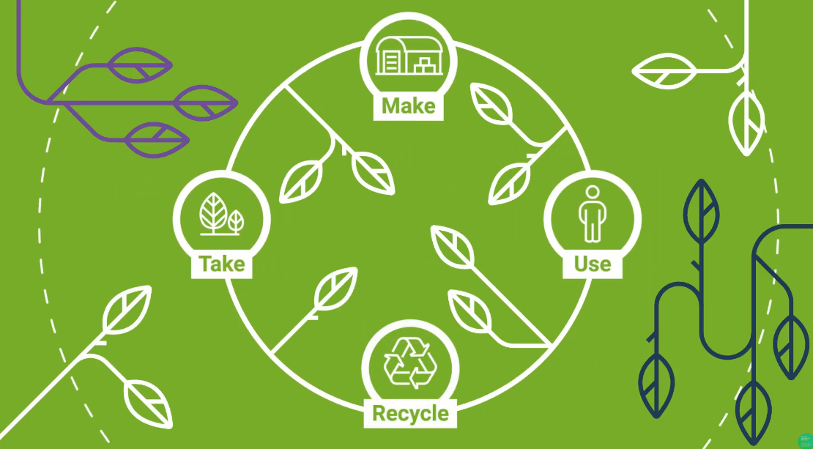
The Bioeconomy reduces Waste!
Linear Economy
Circular Economy
Notes:
Currently, the world follows a linear economy. We follow a supply and demand format, whereby the more people want, the more we make – usually from virgin resources, rather than recycled (virgin materials are natural resources that are extracted in their raw form, e.g. timber from trees, mined metals straight from the ground, extracted fossil fuels). This uses up more of Earths precious materials.
When we’re done with our products, or they break, we throw them away, rarely fixing them, selling them on or recycling. It never used to be like this. Many people reflect on how their grandparents “never throw anything away” and are quick to point out how they are good at repairing clothes, for example. That is because they grew up in an era where people were more conscious about their consumption practices, and things were built to last. Often, they didn’t have the finances to buy new every time something broke either.
Waste also contributes to climate change because sending waste to landfill or energy recovery facilities releases greenhouse gasses into the atmosphere.
However, reusing, recovering or recycling materials removes them from the waste stream, extends their life, reduces the reliance on virgin materials and can be developed into new items. It is more than just recycling, and instead we need to fix things when they break, borrow instead of buy, and then, when there really is nothing more we as individuals can do with it, recycle it appropriately. The most effective thing we can do as a society and as individuals is reduce our consumption and become more responsible consumers. Remember that we operate in a world of supply and demand too. If we demand our products to be better made so they last longer, and if we demand that they are made of recycled materials, eventually businesses will have no choice but to change!
Think:
What was the last thing you bought that you didn’t really need to? How could you have avoided buying it?
Think of something you threw away recently. What else could you have done with it?
Extend:
Encourage students to consider advertisements that try to convince them they need something. What is it that makes us as humans feel like we need the newest pair of trainers despite already having a perfectly good pair already? What is it that makes so many of us feel like we need a new phone every time they are released? By making us feel like we need these items, or that we’re not keeping up if we don’t have them, big businesses continue to profit, but at the cost of our planet!

Slide 7
Why did these changes take place?
What ‘needs’ were being met?
The Journey of the ‘Bag’
Bag in the 1950s
Paper, string, wicker baskets
Bag in 2015
Single use plastic bag
Bag in the future
Cloth, wicker,
bio-plastic, ???
Fact: The plastic bag was initially marketed as good for the environment because, unlike paper bags, they didn’t result in forests being chopped down
Bags have changed a lot over the years. What do you notice about the above?
Notes:
Bags have gone from being made from bio-based resources to non-bio based ones, specifically made from fossil fuels. What will happen in the future? Will we return to the more sustainable practices?
Background and Context
Plastic was first invented in 1907 – over 100 years ago. Plastic bags however, were not patented till 1965. From then it swept throughout Europe and the rest of the world, and the paper bag was almost entirely replaced in under two decades. It was marketed as good for the environment as it didn’t lead to forests being chopped down, and was hailed with many other properties that no other material could live up to! It was waterproof, malleable, could be made really small when transporting and was much stronger than paper, meaning it was able to carry lots of groceries. It made life easier for many people.
In 1997 however, Charles Moore discovered the Great Pacific Garbage Patch, where colossal amounts of plastic waste had accumulated (there were several other areas where this was particularly bad, but this was by far the largest). The link between plastic and the threat to marine wildlife was becoming clear. By 2002, Bangladesh became the first country to ban thin plastic bags because it was concluded that they contributed to flooding by clogging drainage systems. These discoveries coincided with the link between climate change and CO2 emissions from fossil fuels (which plastic is made from). In 2018, David Attenborough presented the true damage that was being caused on Blue Planet II. It is clear now, that our consumption of plastic is not sustainable, and that we need to find alternatives.

Slide 8

Keep an eye out for a solution that links to the Bioeconomy…
Notes:
https://www.youtube.com/watch?v=IW3jEIYBFzg
Watch this BBC video with your class.
Ask students to share what the solution was: Edible chopsticks in china!!!!
Make clear how public pressure has lead to all the changes noted in the film. The action from governments has largely being in response to public pressure!

Slide 9
The Bag
Going back to the bags, think:
How many times can it be used?
Is it biodegradable?
Bag in the 1950s
Paper, string, wicker baskets
Bag in 2015
Single use plastic bag
Bag in the future
Cloth, wicker,
Bio-plastic, ???
Is it made from a sustainable source?
Can it be recycled?
Where in the world does that product come from (carbon footprint)?
What happens when it gets wet?
Is it practical?
Anything else?
Notes:
Explain to students how different materials have different properties. This makes them more or less appropriate for different uses.

Slide 10
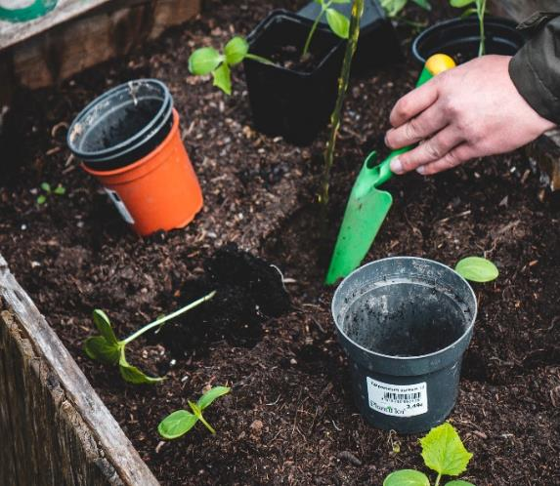
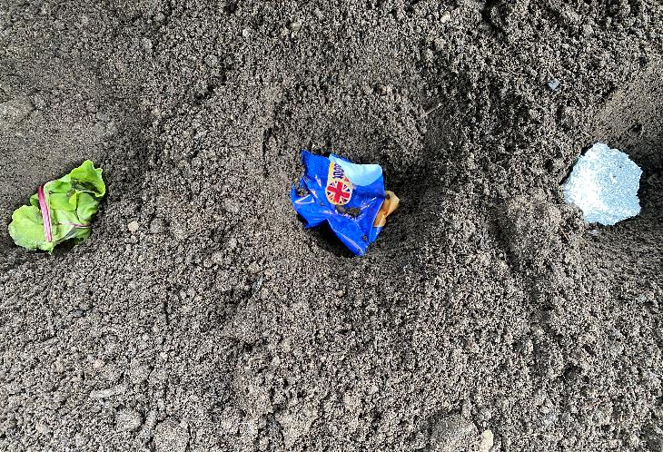
Experiment Time!
In this experiment you’ll be taking on the profession of a biologist – a person that researches bio things. Biologists work in universities, as well as in companies, and for all kinds of reasons – including to improve products and find replacements for plastic!
Notes:
Refer to teacher guidance on page 33 lesson 3

Slide 11
Part 2: Using science to create the bag of the future

Slide 12
Design a research project that can test at least one of these factors on your chosen materials
Strength/durability
Permeability (is it waterproof?)
Sustainability
Recyclability
Practicality
Weight
Style
Anything else?
What is your question?
What do you expect to find? (What is your hypothesis?)
What resources will you need?
Is it feasible? (affordable, not too time consuming etc.)
How are you going to do it? How will you ensure your findings are accurate and reliable?
How will you measure and analyse the data you’ve collected?
Is the experiment safe? What do you need to do to make it safe?
Notes:
We’ve already explored that many factors are considered before someone buys a bag. Something being biodegradable is not enough if it is too weak, too heavy, not waterproof etc. Many people won’t want it if it doesn’t suit their fashion taste. We therefore need to explore some other properties, to decide on the perfect material for a bag. To do this, groups will design their own scientific inquiry into one of the above (or their own decided) property.
Students might chose to design a scientific experiment, or conduct searches online/design a questionnaire/interview. If they chose style, this would suit a questionnaire asking for classroom opinions, for example. Whereas if they choose recyclability, this would be better conducted online. Strength and permeability both lend themselves to scientific methods. Support students in choosing the most appropriate method, taking into account those questions listed on the right.
They may decide to investigate something different, such as affordability. You can remove suggestions from the purple box and allow them to come up with their own ideas as you see fit. You might also chose to do the same for the experimental guidance.

Slide 13
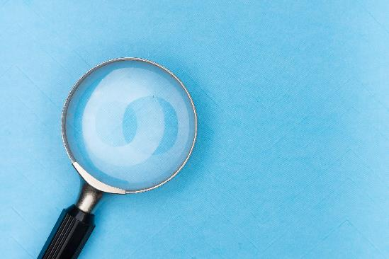
Analysing your findings
This simply means making sense of what you’ve found, and it depends on the experiment you’ve designed.
Do you need to add or tally up?
Do you need to order your numerical responses?
Do you need to organise your findings into themes?
Notes:
Analysis will depend on the scientific method applied.
Examples:
If students choose to conduct an experiment on weight, it is likely they will measure the weight of several materials that cover the same surface area. Their results would therefore be numbers, that can easily be put into order, to signal which is the lightest through to heaviest.
If students decide to conduct an experiment measuring style preferences, they might conduct a questionnaire. This would likely give them statistical and textual data. This would require students to add up the different answers to closed questions (where respondents must select from pre-set answers), or categorise open ended question responses into themes. For example, if the question was “Think of your favourite bag. What is it made of?”, the responses might include “my yellow bag is made of leather”; “I only have plastic bags from Tesco” or “my sports bag – I think its made of plastic.”. Students would have to categorise these into themes such as Leather, Single Use Plastic and Reusable Plastic, and tally responses to determine which was the most frequently mentioned.

Slide 14
Present your findings
Presenting your research findings is an important skill. What ways can we present the data found?
Pie Chart
Word Cloud
Think!
How can you make what you’ve found easily understandable to the rest of the class?
Horizontal Bar chart
Scatter graph
Key quotes
???
Notes:
Remaining in their groups, ask students to create a visual representation of their findings to present to the rest of the class. Their previous experiences of data presentation will direct this part of the session. Can students think of any other ideas to replace the question marks? Will they present both numerical and textual data (quantitative and qualitative)? The second is particularly relevant if they interviewed/sent questionnaires.
As groups present, ask those students listening to record what the other groups have found. They will need this information for that last part of the session.

Slide 15
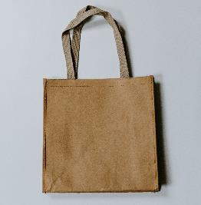
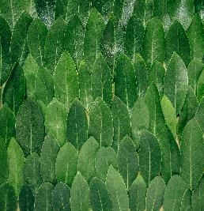
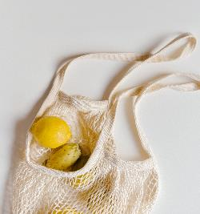
Putting your new knowledge to use…
Design a bio-based bag that takes account of:
Remember how things have changed over time. Could we go back to old, more sustainable, practices?
Look to other countries for inspiration.
What is grown in your local area that could be used?
Strength/durability
Permeability (is it waterproof?)
Sustainability
Recyclability
Practicality
Weight
Style
Anything else
Notes:
This can either be a homework activity, be embedded into this session, or have its own dedicated lesson. Encourage students to look at examples and for inspiration online.
Explain to students that they have considered what is needed for a modern day bag, and have designed and implemented their own experiments based on this. They have shared their findings, and listened to the findings of others. Now it is time to put this into practice

Slide 16
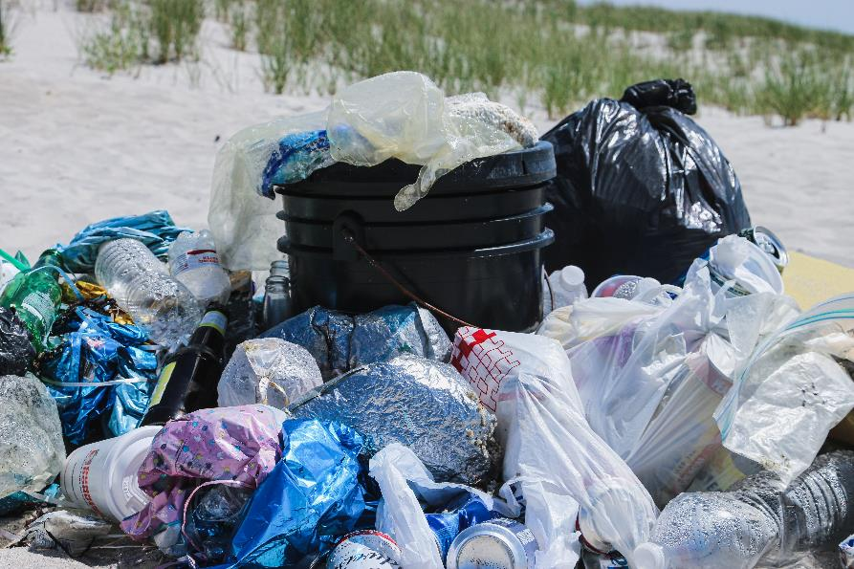
So the question is…
Is it time to bin the plastic bag?

Slide 17
Look at everything you’ve learned
What do you think the most important thing you/we can do is?

Slide 18
(Remember this for the next lesson)
Notes:
Use this page to input students suggestions. We recognise that what students can and cannot do in reference to this is wholly down to their backgrounds and circumstances. Encourage students by letting them know that small actions collectively can make big differences, and that it isn’t about being perfect – its about trying! These will be returned to in Pack 2.
Here are some suggestions if students get stuck.
Take a book from the library to learn more, or research online
Spread the message via social media/posters
Look into the source of my products, and shop more consciously
Make use out of my fruit/veg peelings
Grow my own veg patch
Write to the school and ask them to swap energy providers to a more sustainable one
Reduce amount of fast fashion purchases
Start shopping in charity shops for vintage clothing

