Slide 1
What is the Bioeconomy?
Lesson 2

Slide 2
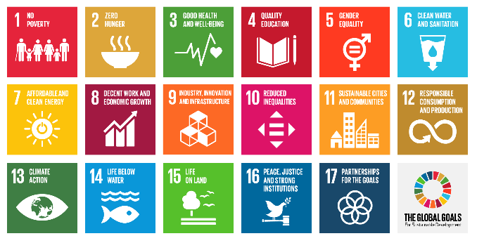
Lesson Objectives
Recognise how sustainable development can be supported by elements of the Bioeconomy
Examine how the Sustainable Development Goal (SDGs) are interrelated and how they underpin one another
Analyse personal consumption practices and behaviours in relation to the SDGs

Slide 3
Lesson Outcomes
Discuss the term sustainability, in relation to society, environment and economy
Categorise the SDGs and identify the links between them
Rank the SDGs in order of priority and provide justification for choices
Suggest how the bioeconomy can help achieve the SDGs explored

Slide 4
Bioeconomy BINGO
Find someone who … (write their names in the box)
Has walked to school | Has grown something from a seed | Has recycled something
Has used leftovers to make another meal | Has ever taken antibiotics | Has a pair of leather shoes
Is wearing something made of wool | Has put something in a compost bin | Uses a refillable water bottle everyday
Bonus points: Which one(s) are the odd one out?
Notes:
Bonus points: Which one(s) are the odd one out?:
Recycled something and uses a refillable water bottle.
These are both sustainable practices, but do not rely on bio-based resources to do so. Therefore they are not the Bioeconomy. Students may pick out ‘walked to school’. Technically humans are a bio resource, so its up to students if they count that or not!

Slide 5
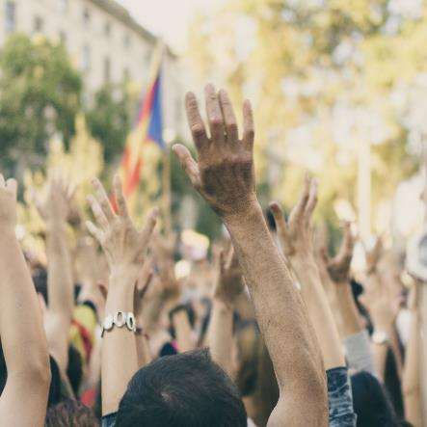
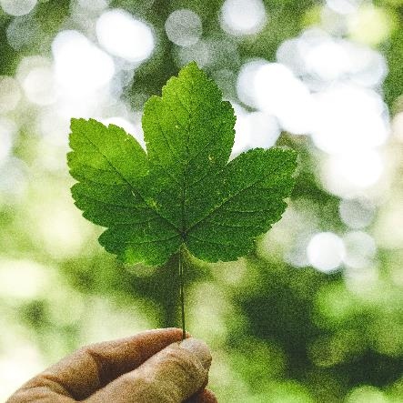
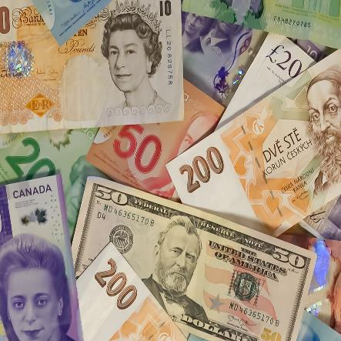
In the last session, we considered the sustainability of current global practices. With your partner, discuss:
What is sustainability?
(and what is it not?)
Society
Environment
Economy
Notes:
Economy, Environment and Society are there as prompts for those students that may need it. This can serve as a recap or as an introduction, depending on student’s exisiting knowledge

Slide 6
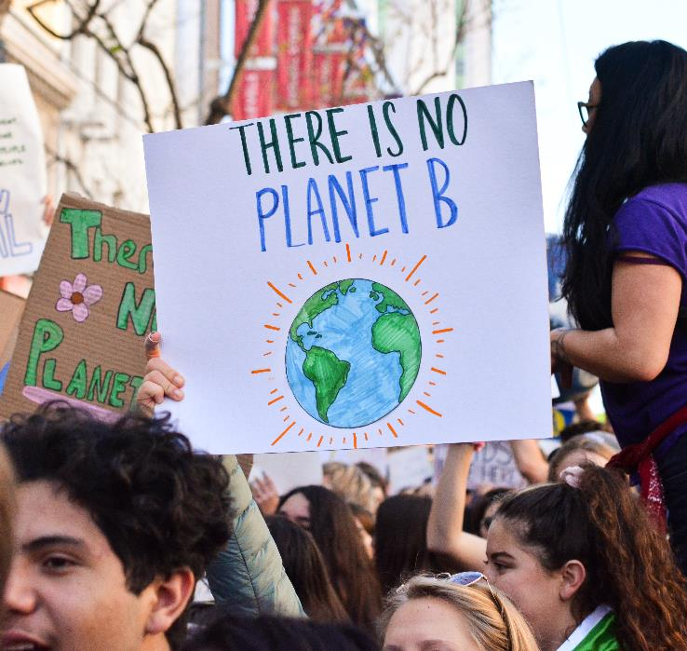
“Sustainability is meeting the needs of the present without compromising the ability of future generations to meet their own needs.”
The Brundtland report, 1987
Notes:
Teacher guidance:
There exists many definitions for sustainability, but this is a frequently cited and often recognised definition throughout the world. Ask students to compare this to their definitions and consider what it means to them. Can they provide examples?

Slide 7
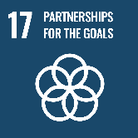
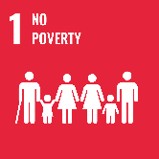
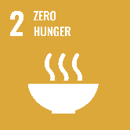

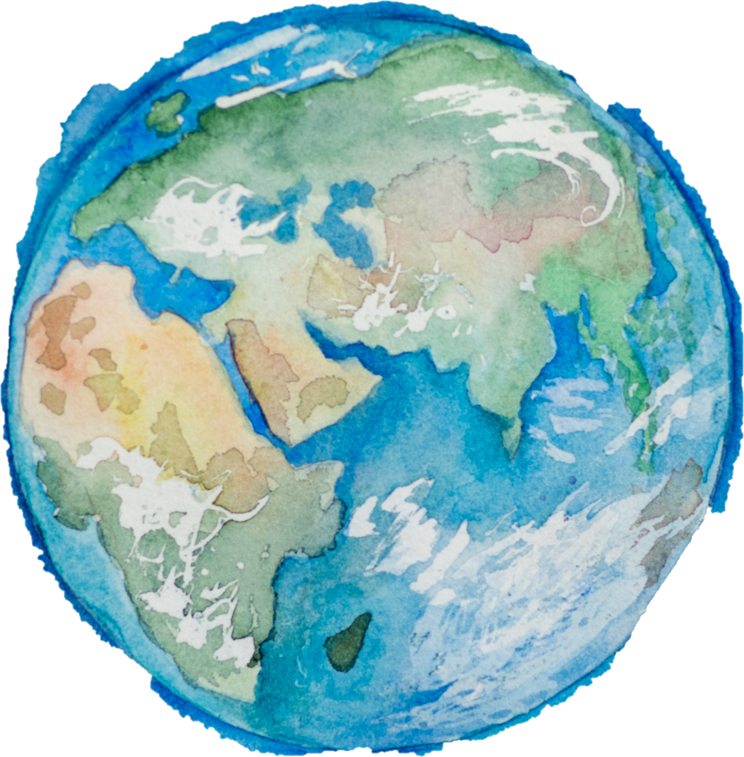
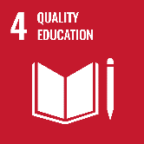
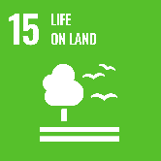
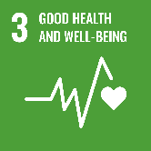
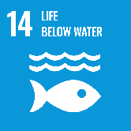
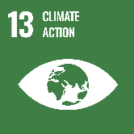
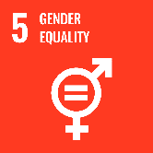
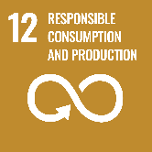
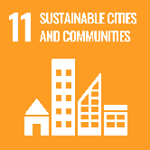
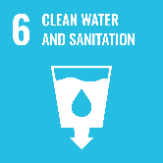
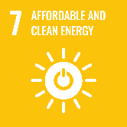
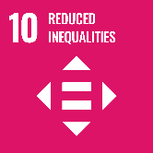
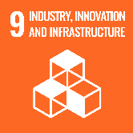
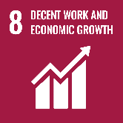
Society
Economy
Environment
Notes:
Teacher guidance:
Ask students if they recognise the square images.
These are the UN Sustainable Development Goals 2030 (SDGs). “The 2030 Agenda for Sustainable Development, adopted by all United Nations Member States in 2015, provides a shared blueprint for peace and prosperity for people and the planet, now and into the future. At its heart are the 17 Sustainable Development Goals (SDGs), which are an urgent call for action by all countries - developed and developing - in a global partnership. They recognize that ending poverty and other deprivations must go hand-in-hand with strategies that improve health and education, reduce inequality, and spur economic growth – all while tackling climate change and working to preserve our oceans and forests.” (UN, 2021). (there exists a wealth of resources online https://sdgs.un.org/goals that aim to teach the SDGs. Any further lessons on this would compliment these packs.
Ask students:
1) Match each SDG to one of the pillars of sustainability – Society, Environment, and Economy.
Guide discussions to conclude that many of the SDG’s overlap with each other and do not fit neatly into one of the three outlined categories. E.g. no poverty depends on a healthy environment that can provide food and water, as well as enough jobs for people to work. People lose their income when climate change causes drought and flooding – both in low income countries and high income countries. The sustainable development of the Earth depends on a healthy environment to provide food, resources and water. An economy cannot be maintained by an unhealthy society who do not have access to these, or who have run out of those necessary.
2) Which SDG do they think is most important? Can they rank them?
This is again more about process than product. The conversations should lead students to debate, and it will reaffirm the linkages.
3) What are humans currently doing that prevents us from meeting these goals?
Encourage students to critically examine their own behaviours, as well as that of society as a whole, businesses and world-leaders. Can they find solutions to overcome these barriers?

Slide 8
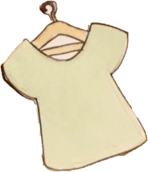


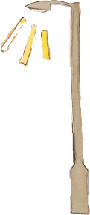
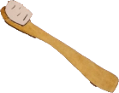


What’s the Bioeconomy again?
Using bio-based resources to create products
and services
It is a way of reducing waste
It is a way of reducing the use of fossil fuels
Bio-based means it came from something living, like plants, animals or bacteria. Synonym: Organic / Living
Examples
Electricity from bio-waste
(like poop and food!)
Everyday products from
bamboo, seaweed
and coffee beans!
Notes:
You might want to watch the bieoconomy videos again here. This will help consolidate the content:
https://www.youtube.com/watch?v=KYvJCIGxPLk&t
https://www.youtube.com/watch?v=hx-jZmE-2_U

Slide 9
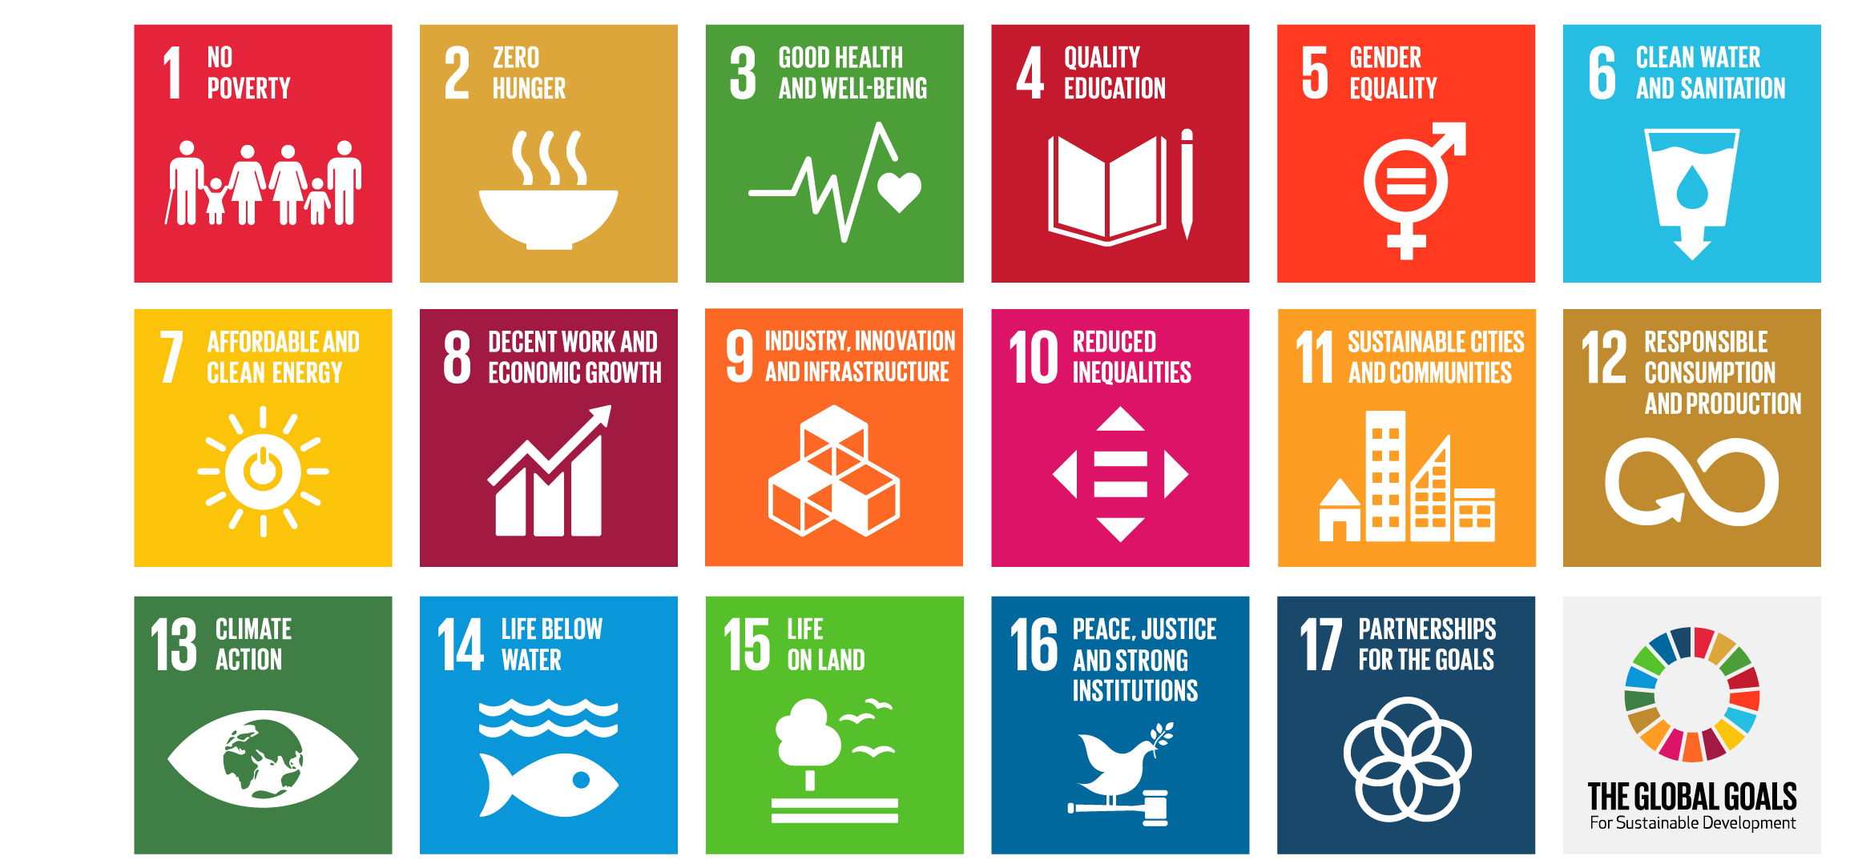
So how does that link to the Bioeconomy?
Which of the SDGs can the Bioeconomy tackle specifically? Give Examples
How can we do this in a way that doesn’t negatively impact another SDG?
Notes:
Examples:
1. No poverty: There will be many jobs in the Bioeconomy as the world progresses. Scientists and inventors to come up with new solutions. These solutions will need marketing consultants, project managers, engineers, environmental auditors, builders, community engagement officers, … and so on! Ample job opportunities can reduce poverty.
2. Zero Hunger: With populations increasing, and therefore demand for food rising, it is essential that the maximum possible is gained from all grown resources. Food waste is one of the biggest landfill contributors, yet a lot of food that ends up there is still perfectly edible. By reducing the amount of food waste by buying more consciously and not wasting as much, we contribute to the Bioeconomy and food security. https://www.rethinkfood.co.uk is a brilliant example of the Bioeconomy.
Challenge: Does this change depending on where you are in the world?
YES! Bamboo is only truly a sustainable resource if it is sourced locally. The types of waste we produce are different globally.
Priorities have to be different depending on where we are.
What could we use locally?

Slide 10
So how does that link to the Bioeconomy?
We know that currently, humans do not tend to live in a sustainable way. Can we use innovation to come up with products that are from bio-based resources?
Notes:
Encourage students to think of examples they already know of, or solutions they have come up with themselves. They may have given examples in the previous slide, so expand on this to get more creative.

Slide 11
Part 2
A closer look
Notes:
The following section can either be an additional lesson, homework, or the main part of this lesson if time permits. It will use real world case studies and individual/group research to further students learning.
There are corresponding print outs for students to use in the teacher guidance (pages 21 to 31 of KS3 Pack 1). These can be explored as the teacher/ educator sees fit, but we suggest breaking the class up into small groups, assigning each group a case study. Students can then be given an allocated amount of time to investigate the case study, and use online sources to inform a presentation about that specific topic in relation to the Bioeconomy. There are question hints on the print outs.

Slide 12
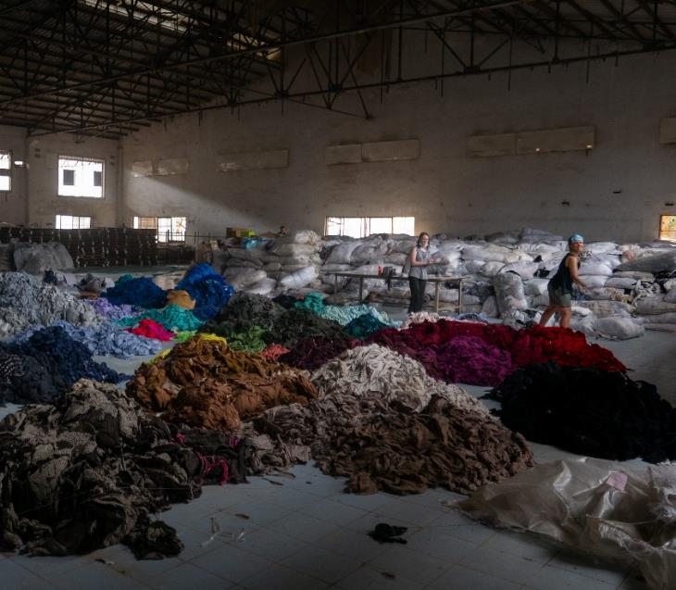
Case Study 1
Fashion and Textiles

Slide 13

The VEJA Story
Notes:
This video won’t autoplay but if you click ‘Watch on youtube’ you can access the video from the slide.
Or Link to Video:
THE VEJA STORY – YouTube
Further video insude VEJA:
INSIDE THE MANUFACTURE OF VEJA - YouTube

Slide 14
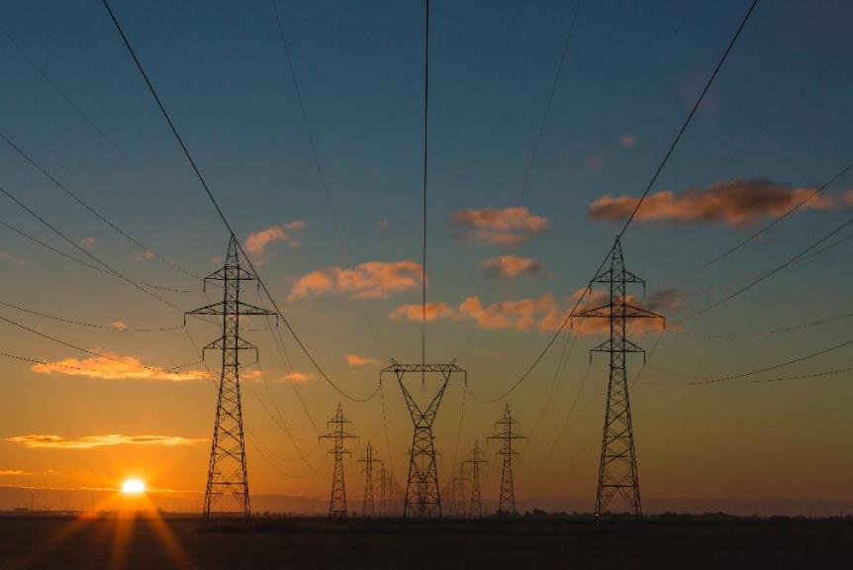
Case Study 2
Energy

Slide 15
Carvey Maigue: Turning waste crops into renewable energy
Notes:
Link to above video:
https://www.youtube.com/watch?v=9HQnIQ6YRGo
Further reading:
https://www.theguardian.com/technology/2020/nov/19/invention-that-makes-renewable-energy-from-rotting-veg-wins-james-dyson-prize
https://www.youtube.com/watch?v=grDN3y5qNYQ
https://www.dyson.com/newsroom/overview/features/november-2020/interview-aureus-system-technology-jda-2020

Slide 16
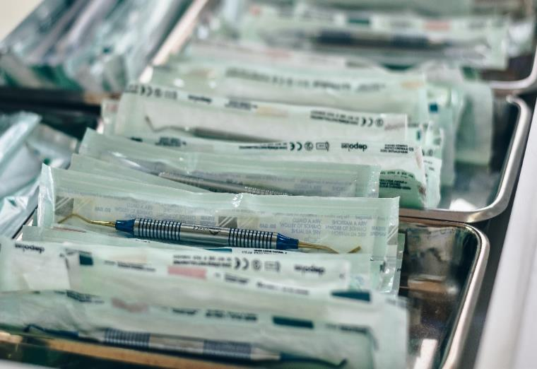
Case Study 3
Medicine and Health

Slide 17
Something fishy is going on … Literally!
Notes:
Link to above video:
https://www.youtube.com/watch?v=5LOG7-2bNhQ
Further reading:
https://www.statnews.com/2017/03/02/brazil-tilapia-skin-burns/
https://www.youtube.com/watch?v=MPctGh6bMEE

Slide 18
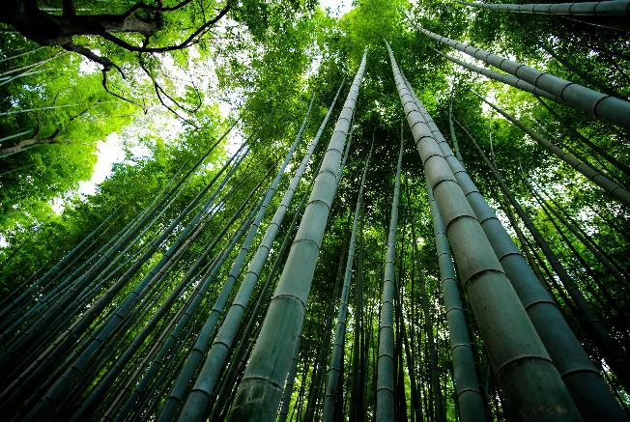
What is the Bioeconomy?
Your turn!
Taking what you have learned, summarise the Bioeconomy in one paragraph.
Challenge:
What is the Bioeconomy NOT? Provide examples.
Notes:
Other video resources:
http://www.biorenewables.org/our-work/case-studies/ - has a number of good examples
Seaweed farm: https://www.facebook.com/BBCLookNorth/videos/1286802871493105
Anaerobic Digestor on a farm, video from the Centre for Sustainable Energy: https://www.youtube.com/watch?v=AgfOjNVekF8
Look at them for solutions – we are able to solve problems with solutions that are economically viable and how bioeconomy can be part of the solution

