Slide 1
Will we ever run out?
Lesson 1

Slide 2
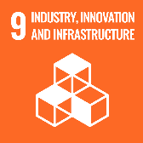
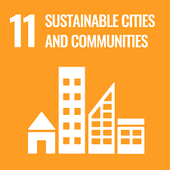
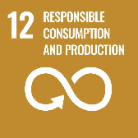
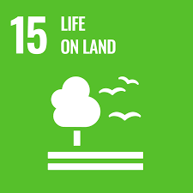
Lesson Objectives
Understand that some resources are limited
Understand that resources can be classified as living and non-living and have different renewal times
Understand that living (bio-based) resources can offer a more sustainable economic model: The Bioeconomy
Define the term Bioeconomy

Slide 3
Lesson Outcomes
Summarise a statement about sustainable development
Describe how Earth’s resources are created
Challenge: Which resources are limited and why?
Sort elements into living and non-living resources
Match resources to a timeline to classify their renewal times
Apply knowledge to respond to the question: Will the earth run out of natural resources?

Slide 4
“Many powerful people in business believe that there is a new challenge in the 21st century: a strong business will be one that can be successful in a world of limited resources. The competitive advantage will be with those who can think outside of the box.”
Janez Potocnik (2013)
Towards the Circular Economy, Ellen MacArthur Foundation
Do now:
Read the statement
In one sentence, summarise what you think Janez Potocnik means
Challenge: Define the meaning of the phrase ‘limited resources’ within this context
Notes:
Starter or Do Now activity. LO and date can be added to this slide. 3-5 mins followed by 5 min sharing a few responses.
Teacher guidance: This statement has been paraphrased from a research document about the advantages of moving towards a circular economy. It is in child speak and is designed to trigger debate and give a clue to the context of this lesson. The phrase ‘limited resources’ is leading students to consider which resources are limited in this century. Eagle eyed students may notice that the words circular economy are in the reference below the statement. This may trigger a discussion about what is the circular economy.

Slide 5



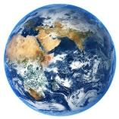



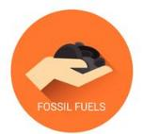


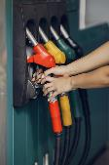

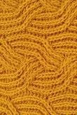
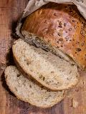
How do we make stuff?
Energy
Living Things
Millions of years
Task: Describe how resources are created (use examples)
Hint: Use the diagram
Challenge: Which resources are limited? Why?
Grown bio-based
products
Mined non-bio-based products
Notes:
Teachers to use the below to support talking through the diagram above.
Context: Everything we use on Earth can be traced back, in one way or another, to the sun. This diagram explains how. There are two types of resources that humans use to make stuff: those that are grown and those that are mined. Those that are grown are living, and rely on the sun for energy to do this. We call this photosynthesis. We use these kinds of resources to make an array of products and services. We turn tree wood into chairs and tables, books and card, and wheat into flour and bread. We turn sheep wool into clothing and blankets, and can even turn seaweed into shoes.
Those that are mined, like crude oil, coal, natural gas, metals and minerals, originally came from plants and animals too. That’s because these things are the remains of plants and animals from millions of years ago, that have been buried, pressed and cooked into the Earths crust. Even though these come from the remains of dead plants and animals that have grown, we don’t categorise them as “grown” resources because the process takes so long (millions of years)! For this same reason, we call mined resources, non-renewable – because we can’t easily make more. (more info on next slide – WAGOLL)
Use slides 5 and 6 depending on ability of students. For higher ability, show them the WAGOLL briefly. Encourage them to write their own description, to show that they have understood the processes. For lower ability students use the WAGOLL to support students. You could also use it as a closed exercise, asking students to fill in gaps on a worksheet, avoiding too much writing. The diagram can be copied by students or printed out from word doc to be stuck into books.

Slide 6
WAGOLL: Describe how Earth’s resources are created
All of Earth’s resources can be traced back to the Sun. Plants capture the Sun’s energy in a process called photosynthesis. This energy is passed on to animals and microbes when they eat plants, and from one animal to another when they eat each other! We use these grown resources to make things like food, leather shoes, wool, paper, wooden tables and so on.
When plants and animals die, they decompose, and their remains are buried and pressed into the Earth’s crust. Over millions of years, they transform into things like crude oil, coal, natural gas, metallic compounds and minerals. Humans mine these materials and use them to make everyday stuff, like soaps, batteries and buildings – even electricity. Resources then, can be divided into two categories: those grown/living, and those mined/non-living!
Challenge: Although both originally come from living things, the resources that are mined are limited. That is because they take millions of years to be created, and they may be trapped deep underground, or under oceans where it is too costly or dangerous to extract them. Because we cannot quickly grow more of these resources, we call them non-renewables.
Either draw a diagram to represent this, or stick a copy of the diagram on the previous slide into your books.
Notes:
15 minutes WAGOLL [What A Good One Looks Like]. To differentiate, students could be given this example with words missing and fill in the blanks.

Slide 7

What about plastic?
Notes:
https://www.youtube.com/watch?v=JgSgEf_tfI8&t=2s

Slide 8
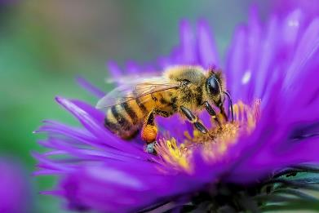
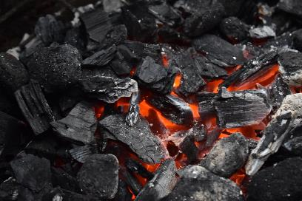
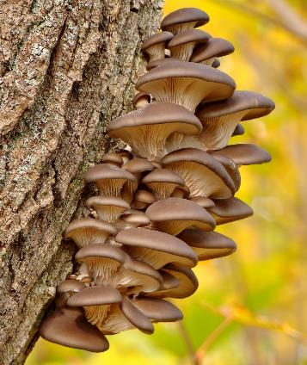
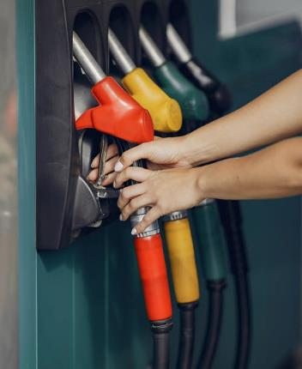
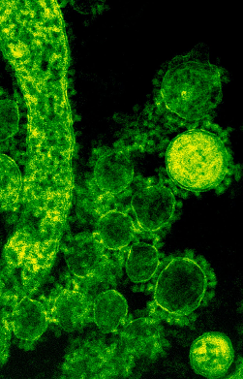
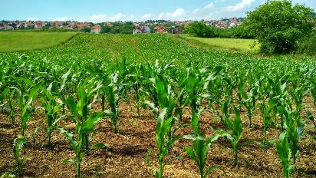
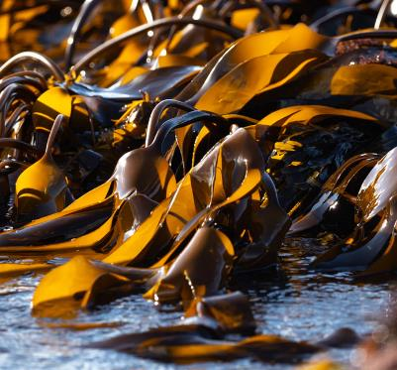
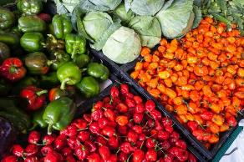
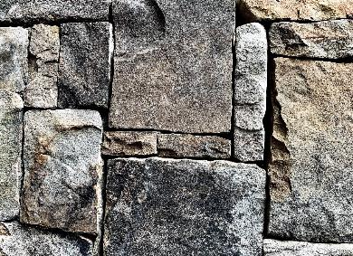
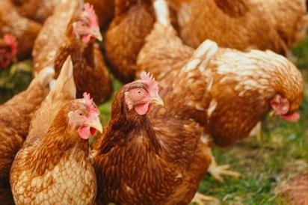
Sort these images into 2 obvious piles
Be ready to explain how you have sorted these images. Think about the key terms you will use in your explanation
Hint:
Living vs Non-Living
Grown vs Mined
Renewable vs Non-Renewable
Notes:
Guidance: Give students 3-5 minutes to work in pairs/groups. We recommend printing these out for students to sort and move around in their groups, and to encourage debate. Only include the bottom right hint if absolutely necessary (can easily be deleted). For higher ability students, present the page without input, and encourage classroom debate during feedback.
This exercise should highlight any misconceptions that need rectifying, and debate will allow students to provide their rationale for why they chose to sort in the way they did. The obvious way to sort would be:
Living/Grown/Renewable: Non-living/Mined/Non-renewable:
Bee Stone/Brick
Chicken Coal
Mushroom Petrol
Fruit and veg
Seaweed
Here would be a good time to encourage students to consider if those grown are automatically renewable.
Pose questions such as:
“Just because we can grow something, does that make it sustainable/renewable?”
Facilitate debate by highlighting that an increase in farming and agriculture has lead to widespread deforestation and natural land depletion. You or your students might also want to discuss the ethics of raising animals for human consumption.
“Which, if any, of these resources can we make electricity from?”
Coal and petrol are the obvious choices, but electricity can be made from plants, and this is becoming increasingly popular. Many farms have anaerobic digesters¹ that make use of food waste (and even chicken poop), turning it into biogas (experiment for this can be found in the ‘Fart in a bottle’ activity in KS3 Pack 2 - Applying the Bioeconomy to your own Environment). Pollination from bees is required to ensure these grow, and there is tentative evidence to suggest electricity can be made directly from bees².
1. http://www.biogen.co.uk/Anaerobic-Digestion/What-is-Anaerobic-Digestion#:~:text=Anaerobic%20digestion%20is%20the%20process,tank%20called%20an%20anaerobic%20digester.&text=The%20word%20Anaerobic%20actually%20means%20'in%20the%20absence%20of%20oxygen'.
2. https://www.researchgate.net/publication/337076178_Devices_to_generate_clean_and_renewable_energy_from_honey_bee_hives

Slide 9





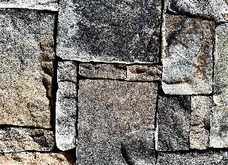

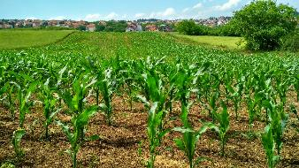


Arrange your images along a timeline, to represent how long they take to create (Don’t worry about specific dates)
300 million years ago
Seasonally Monthly Daily
Notes:
These resources all come from nature, however they all develop at different rates. Ask students to draw a line on some paper/mark something out on their table and label with post-its. Then ask them to use what they know to decide where on the timeline they would go.

Slide 10


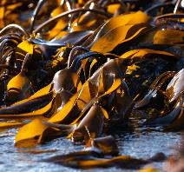

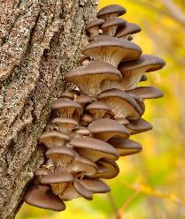
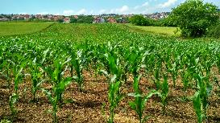
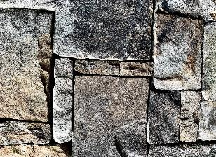



~300 million years ago
Seasonally Monthly Daily
Notes:
Answers to slide 9.
Encourage students to plot some of their own ideas on there (e.g. worms, sand, compost)
Conversation guidance: Renewable and non-renewable is often discussed in relation to energy, but in fact, it encompasses all of Earth’s resources. Return to the conversations had on slide 8. What might the purple line separating the resources mean?

Slide 11
But … what do we use these resources for?
And how do humans make money from them?
Notes:
Guidance:
This can be a class discussion, or pair work.
Crude oil, Coal and Natural Gas (not pictured) are fossil fuels. We use these for heating and electricity. We use crude oil to make plastic. We are now replacing fossil fuels in the production of energy with wind, solar and biogas (gas made from organic materials such as plant and farm waste).
Bees are used to make honey and pollinate plants
Crops are used to make flour and food, and waste can be used to make biogas.
Seaweed can made into bioplastics, food packaging, trainers, skincare and makeup products, lots of food products including cakes and beer!
Mushrooms for meat replacements, bioplastics, skincare products, slippers, packaging, chairs, lampshades etc etc.
Chickens give us eggs and meat for food. Eggs go into cakes, quiches, and many other foods. Chicken poop can be turned into electricity and heating! It also makes pretty good manure for plants.
Fruits and Veggies fill our tummies, but the waste products of this can be used to make compost, wormery food, animal feed, or again, energy!
Stone is used for building and concrete. We make practical and aesthetic things with this (i.e. a bird bath or a house)
Bacteria can be grown to both make and break down plastic! They are used to treat illnesses, cheese, bread and yoghurts, and combatting agricultural pests instead of using pesticides that are extremely damaging to the environment.
We make money by selling what we turn these into as products and services. The coal and biogas fuel the factories that turn raw materials into products.

Slide 12
Will the Earth ever run out of natural resources?
Sentence starters:
I think that the Earth will not run out of resources because …
or
I think that the Earth will run out of resources because …
Success Criteria:
Use the RAG rating
Use your timeline
Use the source materials
Write a short paragraph
Use the challenge words
Challenge words:
non-renewable renewable sustainable
non-sustainable economy fossil fuels
replace linear bio-resource
circular organic
Notes:
RAG (Red-Amber-Green) is also known as traffic light rating

Slide 13
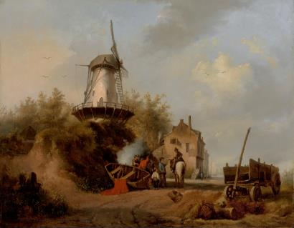
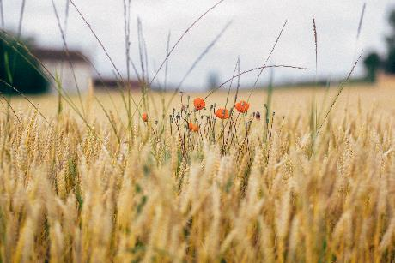
Humans have become very reliant on crude oil for products and energy … but as we have discovered, they will eventually run out! Also, when we use and process crude oil and other fossil fuels, it releases CO₂ into the atmosphere. This is one of the leading causes of climate change. It is essential we find alternative ways to make products and services that don’t rely on fossil fuels, whilst reducing our overall consumption!
Fossil fuel
consumption
1000
2000
3000
Past
(Living off the Land)
Present
(Reliance on Fossil Fuels)
Future
(Living off the Land)
Notes:
The chart above shows how, over the past 100 years or so, we have spiked in our fossil fuel consumption. Before this, we “lived off the land”. We grew our own veggies, raised our own cattle, heated our homes with firewood, and lived much more sustainably. Now, we overconsume, and have big factories to do many jobs for us. These need to be powered, and goods need to be transported however. All this requires energy – and for a long time we have relied on fossil fuels for this. The video on the following page will expand on this.

Slide 14
The Bioeconomy
Notes:
Watch both videos below and decide which one is best suited to your students. The second video goes into more detail, and is aimed typically at an older/high achieving audience. You may chose to show both at different points, depending on the understanding and development of students.
1. https://www.youtube.com/watch?v=KYvJCIGxPLk&t=130s
2. https://www.youtube.com/watch?v=hx-jZmE-2_U&t=56s (to embed this video into the ppt, use the following code <iframe width="560" height="315" src="https://www.youtube.com/embed/hx-jZmE-2_U" title="YouTube video player" frameborder="0" allow="accelerometer; autoplay; clipboard-write; encrypted-media; gyroscope; picture-in-picture" allowfullscreen></iframe>

Slide 15
FOST
Facts … what 5 facts did you learn?
Opinions … what are your opinions on the video?
Surprises … what 5 things surprised you?
Take Further … what do you want to know more about?
F
O
S
T
Notes:
2 to 1 page print out available on page 15 of the Teacher Guidance Material for Pack 1

Slide 16
Finally …
“Many powerful people in business believe that there is a new challenge in the 21st century: a strong business will be one that can be successful in a world of limited resources. The competitive advantage will be with those who can think outside of the box.”
Janez Potocnik (2013)
Towards the Circular Economy, Ellen MacArthur Foundation
We started by reading this statement. Read what you originally wrote. Has your answer and understanding changed? And …
Will we ever run out?
Notes:
This is a brilliant way to encourage students to ‘see’ their learning over the course of the lesson. They should now have a deepened understanding of the term limited resources, and be starting to see how the Bioeconomy can be a part of the solution. The Bioeconomy requires ’outside of the box’ thinking, because many of the solutions don’t exist yet!

