Slide 1



The Midlands, Yorkshire and East Practice Assessment Document (MYE PAD) explained for Practice staff

Slide 2
What is PebblePad?
Find out about PebblePad in less than a minute by clicking this link:
https://www.youtube.com/watch?v=25Bf1xIYvBU
Notes:
Ask the students to

Slide 3
What is MYE PAD?
MYE PAD is a workbook inside the students’ PebblePad account.
The Midlands, Yorkshire and East Practice Assessment Document (MYE PAD) has been developed by the Pan London Practice Learning Group in collaboration with practice partners, mentors, academic staff, students and service users across London, the Midlands, Yorkshire and the East of England regions to support nursing students to achieve the criteria set out in the Future Nurse: Standards of proficiency for registered nurses, (NMC 2018)

Slide 4
Who will be using the MYE PAD?
All nursing students will be using an electronic Practice Assessment Document which will be on a web based platform called PebblePad.
Students currently in their second or third year/part of the nursing programme will be on the existing nursing course and they will continue to use the Electronic Practice Assessment Document (ePAD).
Students starting their nursing course from September 2020 onwards will be using the Midlands, Yorkshire and East Practice Assessment Document (MYEPAD).
This will include degree nurse apprentices and all 4 fields of the undergraduate BSc nursing programme

Slide 5
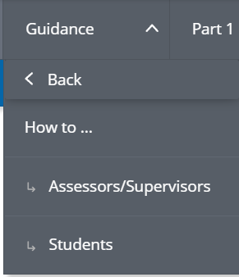
Key differences from ePAD
1 document
No nursing field variance
MYE PAD must be used as directed. As it is a shared document with many other universities it cannot be adapted/changes locally
Guidance built into each section/page
More detailed guidance in separate ‘how to’ sections for assessors and supervisors:

Slide 6
IT/technical support
If you experience any IT/technical problems that you can’t resolve using the guidance/resources in Canvas or in MYE PAD please contact the University of Hull ICT Service Desk using the email address: pebblepad@hull.ac.uk
Please type pebblepad in the subject line of the email and provide as much information in the email as you can and remember to include your name and contact details.

Slide 7
Help with MYE PAD…
There are some help guides in the Guidance tab in MYE PAD for students and practice staff
Practice staff can access support materials on the Placement Team website:
https://www.hull.ac.uk/faculties/fhs/shsw/placement-team
There is further information and guidance on the University’s open access Canvas site: https://canvas.hull.ac.uk/courses/49705/modules#module_37683
These slides and the included resources should be used in conjunction with the Practice Assessor/Practice Supervisor MYE PAD guide, available from https://www.hull.ac.uk/faculties/fhs/shsw/placement-team

Slide 8
Logging in to PebblePad (1)
To login, you need two things:
…and a computer of course!
Your username | This is your full work email, e.g. florence.nightingale@bthft.nhs.uk
Your password | A randomly generated password will be sent to your work email from noreply@pebblepad.co.uk You should change it to something memorable when you first login

Slide 9

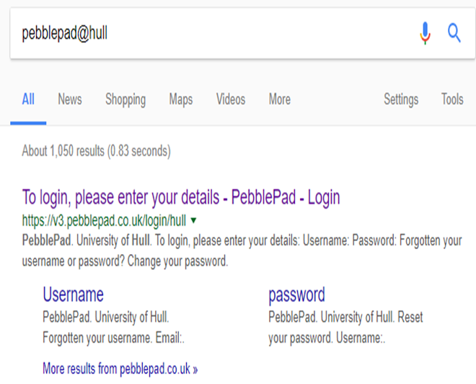
Logging in to PebblePad (2)
Open a browser
On a search engine type pebblepad@hull

Slide 10
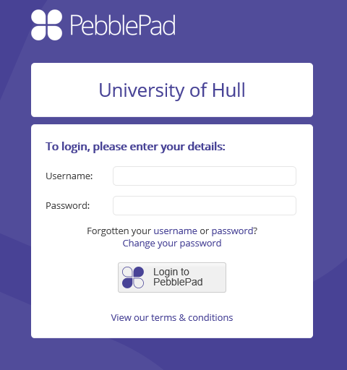
Voila! You’re on the login page
Your work email address
Emailed to you by PebblePad
Use these if you forget your password, or to change it to something easy

Slide 11
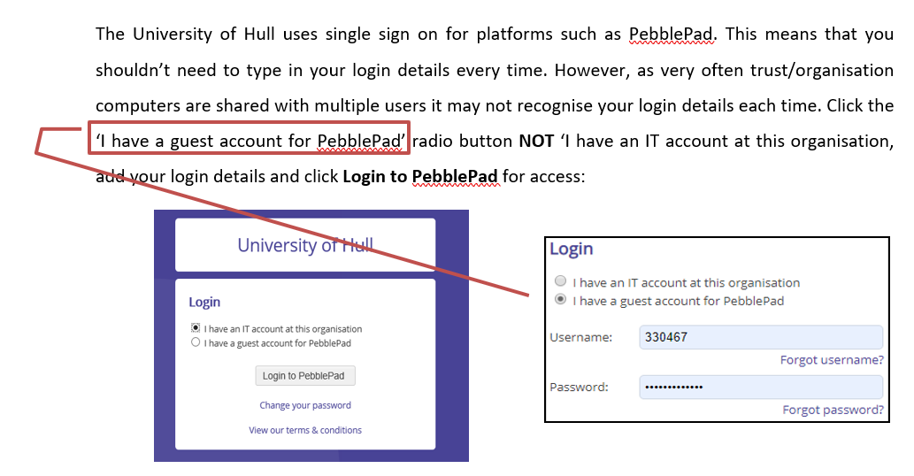
Logging in to PebblePad from Organisation Computers

Slide 12
I am a Practice Assessor, how do I see my student’s MYE PAD?
As a Practice Assessor your student will ‘share’ their MYE PAD with you so that you can complete the assessments and practice assessor sections for the practice placement and the Ongoing Achievement Record (OAR).
As this ‘share’ action is a student responsibility you will have to ensure that you remind students to share their MYE PAD for the purposes of assessment with you on the first day of placement.
It is recommended that you ask a student to do this when they contact you before the placement begins.

Slide 13
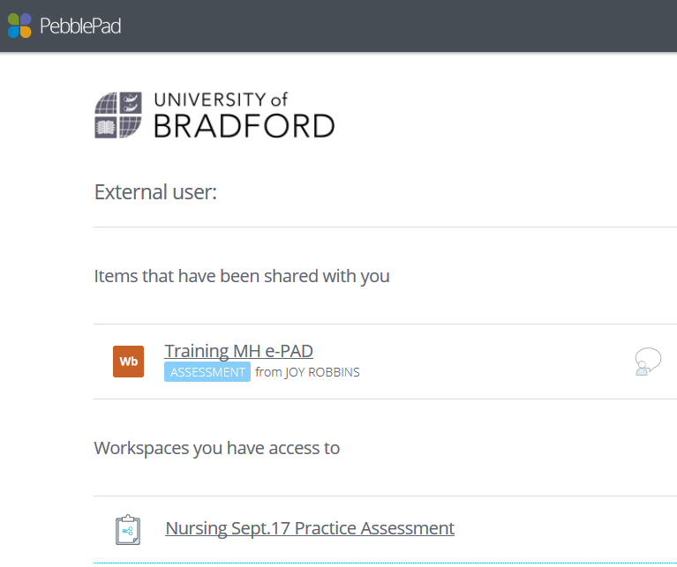
2. Viewing student work
click on your student’s work
*your student needs to share their work with you as an ‘external assessor’ so you can see it listed here. They receive guidance from us on how to do this.
If you don’t see their work yet, they haven’t shared it yet.
Double-check that your student knows your correct email – they need this to share!

Slide 14
I am a Practice Supervisor, do I need access to the MYE PAD?
Practice assessors are responsible for completing the MYE PAD and conducting all the assessments for the placement.
It is not necessary for practice supervisors to have access to the student’s MYE PAD as they are contributing to the assessment process by providing feedback on the student’s performance.
However, there are some Practice Supervisors who may need access, e.g. to complete the initial interview; in these cases it is perfectly acceptable for a student to share their MYE PAD with a practice supervisor.
Students will have to maintain records of when they worked with other professionals. The student has access to paper pdf versions of all the feedback forms as well as access to a mobile phone app with off-line feedback and attendance forms.

Slide 15
Let’s have a closer look at the MYE PAD
Electronic Practice Assessment Document (MYE PAD)
Terminology and Symbols explained for External Assessors and students
The following 4 slides provide an overview of the key features of the MYE PAD

Slide 16
Key Terminology
Assets – is the space where students keep evidence such as feedback or timesheets. All of the items students create within PebblePad or upload into the system are called assets.
Workbook – a template issued by the University, such as the MYE PAD to provide evidence of achievement.
Assessors – anyone who has an assessment function – Practice Assessors, Academic Assessors and External Examiners (for review).
External Assessor- the type of account that assessors need so students can share their MYE PAD with them.

Slide 17
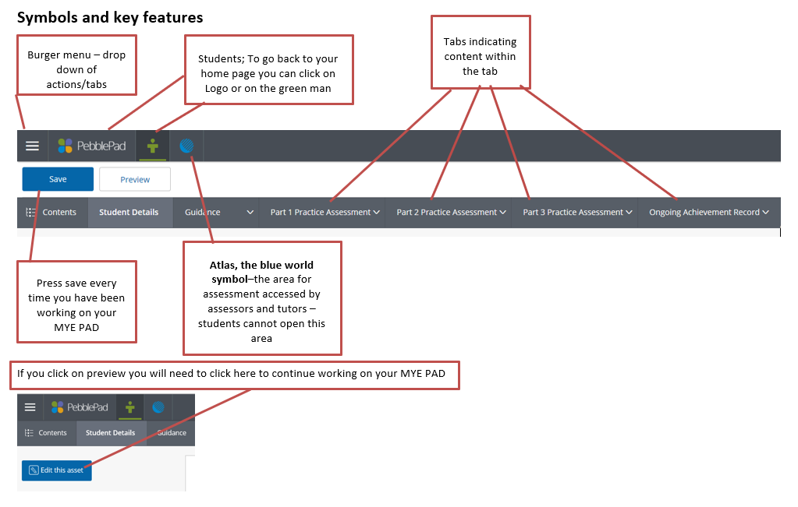

Slide 18
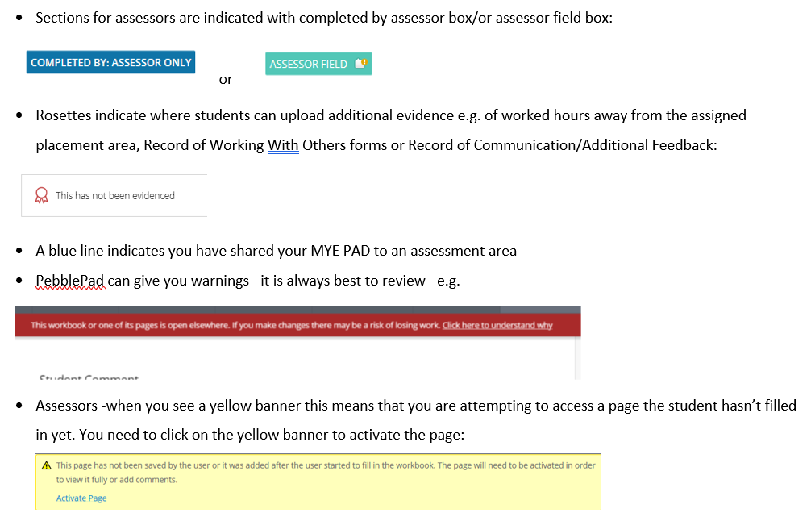

Slide 19


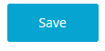
Assessing student work
You can give feedback/ assessment wherever you see these labels:
Usually this will be clicking to say you verify some element in the portfolio, or have done an interview etc.
When you’ve assessed something, scroll to the bottom of the page and click the ‘Save’ button:
Please don’t forget to save. Please.

Slide 20
MYE PAD Key components
The MYE PAD is divided into tabs across the screen:
There is guidance on each page in the MYE PAD which you can access by clicking the pdf links.

Slide 21
MYE PAD explained
Please watch the video presentation that guides you through the process of completing the MYE PAD.
It is about 16 minutes long:
https://cdnapisec.kaltura.com/p/1355621/sp/135562100/embedIframeJs/uiconf_id/38386321/partner_id/1355621?iframeembed=true&playerId=kplayer&entry_id=1_88b04uac&flashvars[streamerType]

Slide 22
MYE PAD demo version
You can access a demo version of the MYE PAD from this link:
https://v3.pebblepad.co.uk/spa/#/public/W887ntcHhtRMW7tzrWH8qMtRqr
Please use this resource to familiarise yourself with the content and functions of the MYE PAD.
Further information and ‘How to’ guides are also available in the students MYE PAD.

Slide 23
Additional resources
All sections of the MYE PAD are available at the PAN Midlands website as a downloadable version with a slightly different format. This would show you all the content across the whole programme if you would like to see that. It can be found at this link: https://www.myeplg.ac.uk/
Visit the University of Hull Placement Team website for a demo version of the MYE PAD as well as the full MYE PAD help guide for Practice Assessors and Practice Supervisors: https://www.hull.ac.uk/faculties/fhs/shsw/placement-team

